Slide 1
Aplastic anemia and PNH
Loree Larratt
Clinical Hematologist University of Alberta Edmonton

Slide 2
Disclosures
Advisory board and speaker honorarium: Alexion and Novartis
Laboratory Grant to support adamts 13 and genetic testing Alexion
Clinical Trials Activity Alexion (eculizumab and Axln 1210)
Apellis C3 inhibitor
Registry PNH (open) and Atypical HUS (closed) Both sponsored by Alexion
Slides courtesy pnh network

Slide 3
Aplastic Anemia
Misnomer “Aplastic Pancytopenia”
Incidence: 2 – 4 / Million / year
Young adults with second peak in 5th or 6th decade of life

Slide 4
Presentation
Cytopenia:
  Anemia
    Low red blood cell count
    Fatigue, pallor, hear pulse in head
  Thrombocytopenia
    Low platelets
    Bruise easily, petechiae (pinpoint red spots)
  Neutropenia
    Low white count
    Impaired immune function, susceptible to infection, viruses

Slide 5
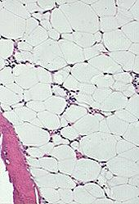
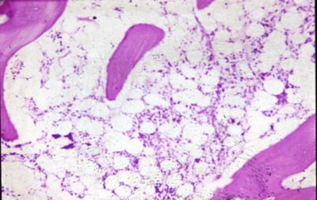
Bone Marrow

Slide 6
Lab Ancillary tests
Bone marrow biopsy to rule out hypoplastic MDS
Cytogenetics to rule out MDS & congenital disorder Fanconi’s Anemia
NGS for Fanconis and myeloid genetic abn
Flow cytometry (CD55 & CD59) to rule out PNH
Liver function tests
Flow cytometry to rule out Large Granular Lymphocyte leukemia, Hairy Cell Leukemia
HLA typing for BMT
  increased DR15 in AA & PNH patients

Slide 7
Pathogenesis
Primary defect or damage to stem cell or less commonly microenvironment
Evidence for immune mechanism:
  Autologous engraftment after allogeneic transplant
  Failure of engraftment with syngeneic transplant
  Response to immunosuppressive therapy

Slide 8
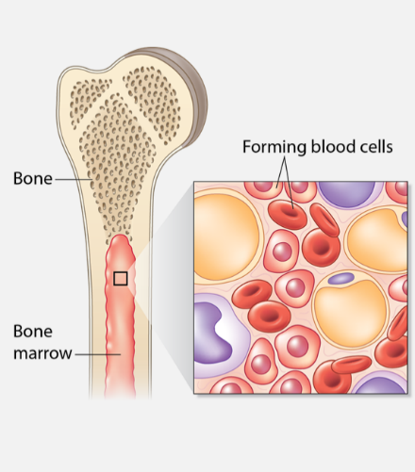
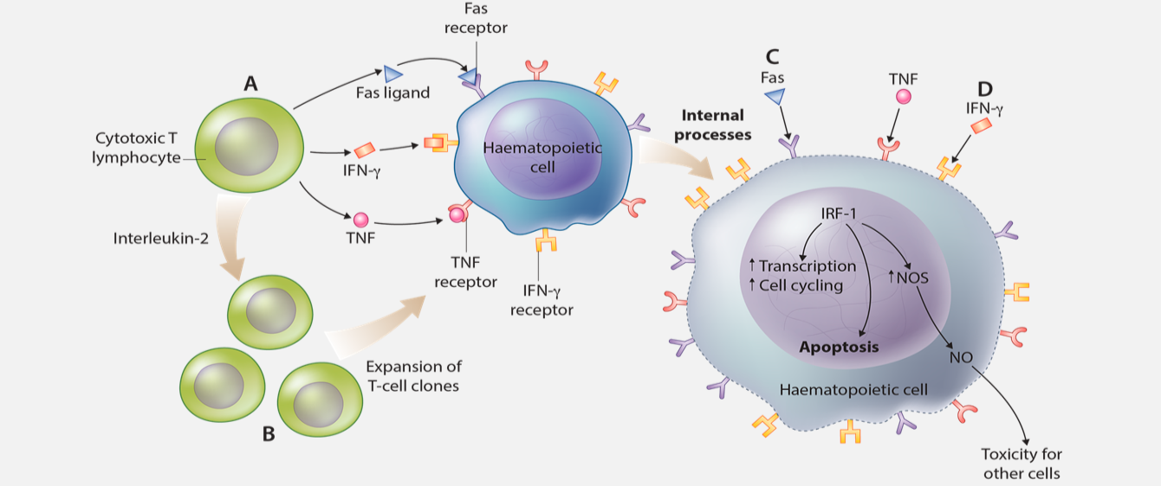
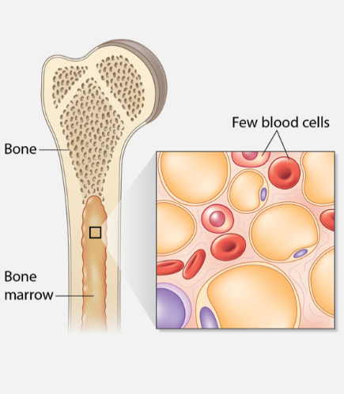
Aplastic anemia (AA) is an immune-mediated attack of hematopoietic stem cells, leading to bone marrow destruction
Proposed pathophysiology of aplastic anemia¹
Healthy bone marrow³
Aplastic bone marrow³
An immune response, led by an expanded cytotoxic T cell population, targets HSCs and progenitor cells²
  Directed at CD34⁺ cells²
  T cells induce apoptosis and hematopoietic failure²
CD, cluster of differentiation; HSC, hematopoietic stem cell; IFN, interferon;
IRF, interferon regulatory factor; NO, nitric oxide; NOS, nitric oxide synthase;
TNF, tumor necrosis factor
1. Young NS & Maciejewski J. N Engl J Med 1997;336:1365–1372;
2. Young NS et al. Curr Opin Hematol 2008;15:162–168; 3. University of Minnesota Medical Center, Fairview, https://www.fairview.org/HealthLibrary/Article/40317

Slide 9
Etiology
Idiopathic 40 – 70 %
Constitutional
Irradiation (> 7Gy Irreversible: >5Gy 50%)
Drugs
Toxins
Infections (Hepatitis, Mono , Parvo)
Pregnancy
PNH

Slide 10
What are the treatment options for SAA?
SAA
Age
<40 years
>40 years
Matched family donor available
Yes
No
HSCT
IST
No matched family donor or patients ≥40 years
Failure/relapse
Unrelated & alternative BMT/other treatments
BMT, bone marrow transplant;
HSCT, hematopoietic stem cell transplant; IST, immunosuppressive therapy
Marsh JCW et al. Br J Haematol 2009;147:43–70

Slide 11
Immunosuppressive therapy is an effective treatment for patients ineligible for HSCT
IST: Standard regimen consists of hATG and CSA¹
Study | Years | N | Median age (years) | Response (%) | Relapse (%) | Clonal evolution (%) | Survival
Germany | 1986–1989 | 84 | 32 | 65% | 19% | 8% | 58% at 11 years
NIH | 1991–1998 | 122 | 35 | 61% | 35% | 11% | 55% at 7 years
EGBMT | 1991–1998 | 100 | 16 | 77% | 12% | 11% | 87% at 5 years
Japan | 1992–1997 | 119 | 9 | 68% | 22% | 6% | 88% at 3 years
Germany/Austria | 1993–1997 | 114 | 9 | 77% | 12% | 6% | 87% at 4 years
Japan | 1996–2000 | 101 | 54 | 74% | 42% | 8% | 88% at 4 years
NIH | 1999–2003 | 104 | 30 | 62% | 37% | 9% | 80% at 4 years
EGBMT | 2002–2008 | 192 | 46 | 70% | 33% | 4% | 76% at 6 years
NIH | 2003–2005 | 77 | 26 | 57% | 26% | 10% | 93% at 3 years
NIH | 2005–2010 | 120 | 28 | 68% | 28% | 21% | 96% at 3 years
Iran | 1998–2013 | 63 | 31* | 57% | 23% | 6% | 49% at 15 years
*mean age
CSA, cyclosporine A; EGBMT, European Group for Bone Marrow Transplantation;
hATG, horse antithymocyte globulin; NIH, National Institutes of Health
1. Scheinberg P & Young NS. Blood 2012;120:1185–1196;
Table: Young NS et al. Blood 2006;108:2509–2519

Slide 12
Pathogenesis
Primary defect or damage to stem cell or less commonly microenvironment
Evidence for immune mechanism:
  Autologous engraftment after allogeneic transplant
  Failure of engraftment with syngeneic transplant
  Response to immunosuppressive therapy

Slide 13
Treatment failure
Exhaustion of stem cell reserves
  Immune mediated AA
Insufficient Immunosuppression
  Persistent attack
Misdiagnosis
Hereditary Bone Marrow failure
  Non-immune pathogenesis

Slide 14



Patients may become refractory to IST, requiring efficacious second-line treatments: Eltrombopag
First-generation TPO-R agonist
  Binds to the transmembrane domain of TPO-R, acting in synergy with TPO to stimulate hematopoiesis¹
Eltrombopag
(Refractory AA)
40% response rates observed with eltrombopag in refractory SAA patients²
  7/17 patients exhibited tri-lineage responses at follow-up²
  Five patients tapered off drug following robust response – median duration without drug: 13 months²
Eltrombopag has a favorable toxicity profile, with reversible transaminitis the only dose-limiting toxicity²
TPO, thrombopoietin; TPO-R, TPO receptor
  1. Erickson-Miller CL et al. Stem Cells 2009;27:424–430;
  2. Desmond R et al. Blood 2014;123:1818–1825
Notes:
Higher affinity for SSTR5, and similar affinity for SSTR2, compared with first-generation SSAs
In patients uncontrolled on first-generation SSAs, 15.4% (40 mg) and 20.0% (60 mg) receiving pasireotide LAR achieved biochemical control* after 24 weeks (*GH <2.5 μg/L and normalized IGF-1)

Slide 15
Eltrombopag remains efficacious in ‘real-world’ clinical practice
Nationwide survey on the use of eltrombopag in patients with severe aplastic anemia: Report on behalf of the French reference center for aplastic anemia
Lengline E et al. Blood 2016;128:abst 2684
Hematological response was observed in 40% of patients,¹ comparable with previously published clinical trials²
11 treatment-naïve
Eltrombopag: median duration
6 months
48.6% of patients transfusion independent
Liver toxicity (cytolysis) most common side effect (n=11, 24%)
48% of patients remained on treatment
46 SAA patients
17 months after diagnosis
35 refractory to IST
Eltrombopag: median duration
6 months
36.4% of patients transfusion independent
1. Lengline E et al. Blood 2016;128:abst 2684;
2. Desmond R et al. Blood 2014;123:1818–1825

Slide 16
Regular assessment of somatic mutations with eltrombopag treatment may help identify risk of disease progression
Clonal dynamics of refractory aplastic anemia in patients treated with eltrombopag
Patel B et al. Blood 2016;128:abst 3892
26 refractory AA patients received eltrombopag for 12 weeks of therapy:
15/26 responded (58%)
3 non-responders
A case-control cohort of 26 refractory AA patients did not receive eltrombopag
23% (6/26) exhibited expanded PNH granulocytes
15% (4/26) exhibited subclonal chromosomal abnormalities
50% (13/26) exhibited expanded
PNH granulocytes
No significant difference between groups
in expansion of PNH clones
23% of eltrombopag patients acquired new somatic mutations; serial evaluation of somatic mutation may provide a useful biomarker for risk of post-AA MDS
MDS, myelodysplastic syndromes; PNH, paroxysmal nocturnal hemoglobinuria
Patel B et al. Blood 2016;128:abst 3892

Slide 17
Monitoring for cytogenetic abnormalities and progression to MDS/AML, and BM fibrosis
Perform peripheral blood smear prior to starting eltrombopag
BM aspirate to exclude abnormal cytogenetic clone typical of MDS/AML, particularly monosomy 7
Repeat BM aspiration for cytogenetics at 3 months and 6 months
Monthly blood film examination for signs of BM fibrosis, eg
    Tear drop poikilocytes
    Nucleated red cells
    Immature white cells
    Cytopenias
    If any of the above on blood film, perform BM biopsy with reticulin stain for fibrosis
If new or worsening cytogenetic abnormalities are observed, consider discontinuation
Revolade (eltrombopag) summary of product characteristics revised 11/2016: http://www.medicines.org.uk/EMC/medicine/22949/SPC/Revolade/ Last accessed May 2017

Slide 18
Eltrombopag as a first-line treatment option for SAA (1)
Hematologic response
hATG
Day 1–4
3 months
6 months
CSA×6 months
Cohort 1
Eltrombopag 150 mg
Day 14 to 6 months
5-year
follow-up
Cohort 2
Eltrombopag 150 mg
Day 14 to 3 months
Cohort 3
Eltrombopag 150 mg
Day 1 to 6 months
  Primary endpoints: Complete response (CR) rate at 6 months and safety
  Secondary endpoints: Overall response (OR), partial response (PR), survival, clonal evolution and relapse
CR = ANC ≥1×10⁹/L, hemoglobin ≥10 g/dL and platelets ≥100×10⁹/L
PR = Blood counts no longer meeting criteria for SAA or CR
ANC, absolute neutrophil count
Townsley DM et al. N Engl J Med 2017;376:1540–1550

Slide 19
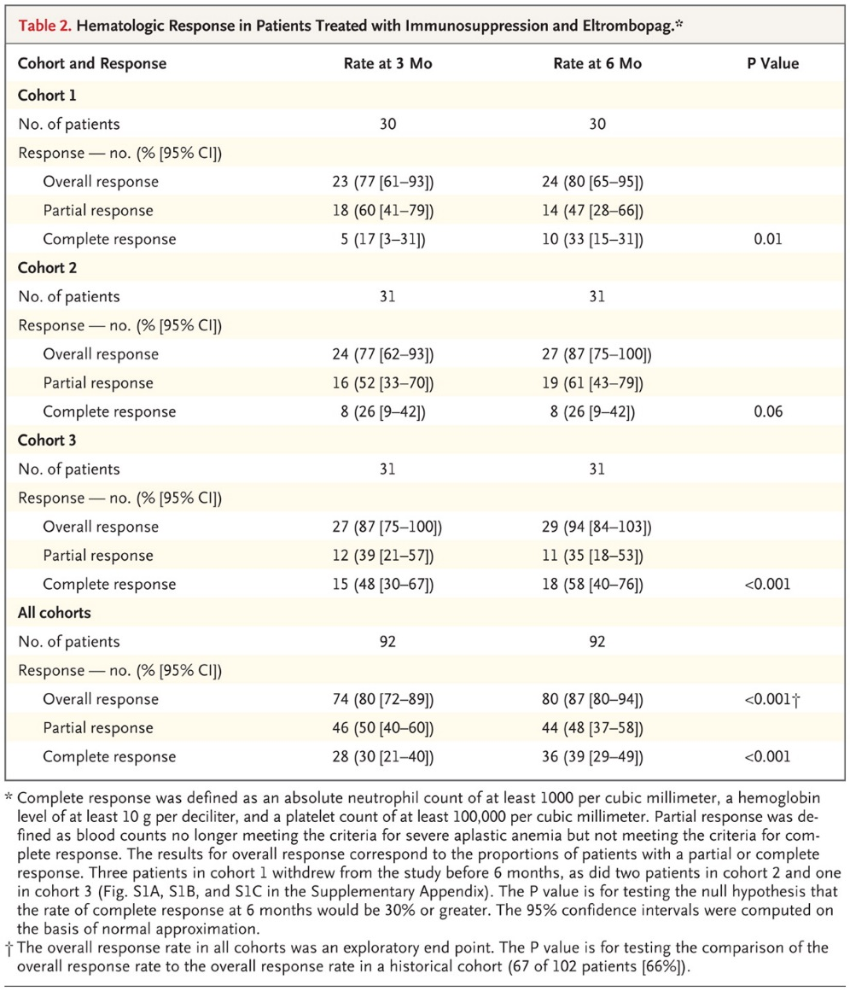

Townsley DM et al. N Engl J Med 2017;376:1540-1550.
Hematologic Response in Patients Treated with Immunosuppression and Eltrombopag.

Slide 20
BMT
Only curative therapy
Matched allogeneic
  Donor available 25%
  Survival 80 – 90 % decreasing with adv age
  30 – 35 year cut off
MUD (matched unrelated donor)
  40 % < 20 ; 30% 21 – 40 y
  Older patient IS > BMT

Slide 21
Summary
HSCT (if possible) and IST remain the treatment of choice for SAA – supportive care remains a critical facet to improving survival
Eltrombopag represents an efficacious treatment for refractory SAA patients:¹
  40% hematological responses observed in the ‘real-world’, as well as possible tri-lineage responses
  TPO-R agonists may predispose to clonal evolution
Recent data suggest that in the future, eltrombopag may be useful in the first-line treatment setting for SAA²
Trials are ongoing to further determine the efficacy and safety of TPO-R agonists in treatment naïve and refractory AA
1. Desmond R et al. Blood 2014;123:1818–1825;
2. Townsley DM et al. N Engl J Med 2017;376:1540–1550

Slide 22
CURRENT UNDERSTANDING OF PNH
Acquired, progressive hematopoietic stem cell disease affecting multiple lineages
Linked to uncontrolled activation of immune system’s complement cascade
Rare: Frequency 2–6 per million (estimated based on frequency of the related disorder aplastic anemia)
  Estimated 4000–6000 patients in US (potentially 400 to 600 in Canada)
Diagnosed at all ages – median age is early 30s
Chronic, disabling, and life-threatening
  5-year mortality: ~35%
1. Young NS et al., 1986.; 2. Vincent PC., 1986.
Notes:
Estimates of PNH incidence and prevalence vary, but the 2-6 per million figure is often cited and generally accepted. A recent survey in Europe provided slightly different estimates, which may or may not be representative of the more general population:
PNH Incidence = 1-2 new cases/year per million population
Overall PNH Prevalence = 15.9/million population
Reference: Gulbis B, Eleftheriou A, Angastiniotis M, Ball S, Surrallés J, Castella M, Heimpel H, Hill A, Corrons JL. Epidemiology of rare anaemias in Europe. Adv Exp Med Biol. 2010;686:375-96.

Slide 23
PNH: A CHRONIC, DISABLING, AND
LIFE-THREATENING DISEASE
Actuarial survival from the time of
diagnosis in 80 patients with PNH
100
80
Age- and sex-
matched controls
60
Patients surviving (%)
40
35%
of PNH patients die
within 5 years
of diagnosis
20
Patients with PNH
0
0
5
10
15
20
25
Years after diagnosis
From New England Journal of Medicine. Hillmen P et al., Natural history of paroxysmal nocturnal hemoglobinuria. 333: 1253-1258.
Copyright © 1995 Massachusetts Medical Society. Reprinted with permission from Massachusetts Medical Society.
The expected survival of an age- and sex-matched control group is shown for comparison.¹
In a patient population where half the patients have <30% clone, one in seven patients died by 5 years.²
1. Hillmen P et al., 1995.; 2. de Latour RP et al., 2008.

Slide 24

PNH: UNCONTROLLED COMPLEMENT
Lectin pathway
Classical pathway
Alternative pathway
Immune complex clearance
Microbial opsonization
C3
C3 + H₂O - ALWAYS ACTIVE
(chronic)
Proximal
Amplification
PNH: Loss of CD59, CD55
CD55
-
C5
Terminal
CD59
-
  C5a
Potent anaphylatoxin
Chemotaxis
Proinflammatory activity
Leukocyte activation
Endothelial activation
Prothrombotic activity
  C5b-9
  Membrane Attack Complex
Cell lysis
Proinflammatory activity
Platelet activation
Leukocyte activation
Endothelial activation
Prothrombotic activity
Anaphylaxis
Inflammation
Thrombosis
Consequences
Consequences
Cell destruction
Inflammation
Thrombosis
Notes:
KEY POINTS:
Chronic uncontrolled complement activation in PNH leads to devastating consequences
Complement is activated to allow rapid first-line immune responses
Insufficient regulation of the complement cascade can have highly destructive effects
In PNH, the deficiency of complement inhibitors leads to chronic, uncontrolled complement activation, resulting
in chronic hemolysis and granulocyte and platelet activation
BACKGROUND INFORMATION:
Complement
Primary component of innate immunity
Responsible for opsonization, immune complex clearance, targeted pathogens
Highly regulated cascade with inhibitor proteins (Factor H, Factor I, MCP, CD55)
C3
C3 is a pivotal component of the complement system because it can be activated via all 3 pathways
Cleavage of C3 leads to C3a formation, a mild proinflammatory anaphylatoxin, and C3b
Binding of C3b to other components modulates complement activation by
Amplification of the alternative pathway
Inactivation of C3b
C5
C5 cleavage leads to generation of C5a, a prothrombotic potent analphylatoxin, and formation of the
MAC (C5b-9)
Consequences of uncontrolled complement activation in PNH
C5a mediated: Anaphylaxis, inflammation, and thrombosis
C5b-9 mediated: cell destruction, inflammation, and thrombosis

Slide 25
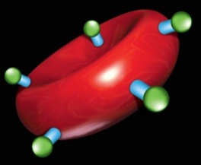
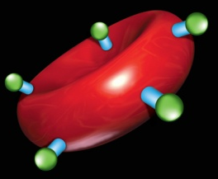



PNH: CONSEQUENCES
Normal RBCs are protected from complement attack by a shield of terminal complement inhibitors (GPI-anchored proteins – most important are CD55 and CD59)
Without this protective complement inhibitor shield, PNH RBCs
are destroyed
Complement
activation
Lack of bound CD55 and CD59 leads to uncontrolled complement activation
Intact RBC
Reduced red cell mass
Anemia
Free hemoglobin
GPI = glycosylphosphoinositol.
1. Parker C et al., 2005.; 2. Brodsky R in Hoffman R et al., eds. 2005.; 3. Rother RP et al., 2005.; 4. Socié G et al., 1996.;
5. Hill A et al., 2007.
Notes:
Key Points:
Historically, PNH was viewed as a hemolytic anemia. Normal RBCs are protected from complement-mediated destruction through the GPI-anchored proteins (in blue and green) on cell surface.
Without the protective complement inhibitor proteins expressed on the surface (CD55/CD59), the RBCs are susceptible to lysis.
Massive reduction in RBC mass leads to anemia and fatigue (fatigue is more commonly a symptom of hemolysis) with a significant increase in free hemoglobin levels.
Anemia was historically the most commonly recognized clinical symptom.

Slide 26


CHRONIC UNCONTROLLED COMPLEMENT ACTIVATION LEADS TO DEVASTATING CONSEQUENCES
Thrombosis
Renal failure
Pulmonary hypertension
Significant impact on survival
Complement
activation
Abdominal pain
Chest pain
Elevated LDH
Dyspnea
Dysphagia
Free hemoglobin
Fatigue
Significant impact on morbidity
Decreased NO
Hemoglobinuria
Erectile dysfunction
LDH = lactate dehydrogenase.
1. Parker C et al., 2005.; 2. Brodsky R in Hoffman R et al., eds. 2005.; 3. Rother RP et al., 2005.; 4. Socié G et al., 1996.;
5. Hill A et al., 2007.; 6. Lee JW et al., 2010 .; 7. Hill A et al., 2010.; 8. Hillmen P et al., 2010.
Notes:
Key Points:
Hemolysis results in increased circulating free hemoglobin and nitric oxide scavenging. These result in the wide range of symptoms seen in PNH.
Consequences that impact survival:
Thrombosis
Renal failure
Pulmonary hypertension
Abdominal pain
Dyspnea
Symptoms that impact morbidities:
Dysphagia
Fatigue
Hemoglobinuria
Erectile dysfunction

Slide 27
CLINICAL FEATURES OF PNH
Key/classic features:
Intravascular hemolysis
Thrombotic events (particularly in unusual sites)
Bone marrow failure
Other important features:
Renal dysfunction/failure
Pulmonary hypertension
Abdominal and/or chest pain
Erectile dysfunction
Impaired quality of life

Slide 28
TYPICAL PRESENTATION OF PNH
Pep (energy)
Paroxysms
Pallor
Pulmonary
Pain
Penis
Fatigue: 96%¹
Hemoglobinuria: 26%²
Anemia: 88%³
Dyspnea: 66%¹
Abdo pain: 57%¹; Dysphagia: 41%¹
Erectile dysfunction: 47%¹
¹ Myers et. 2007; ² Dacie et al. Sem Hematol 1972; ³ Nishimura et al. Medicine 2004

Slide 29
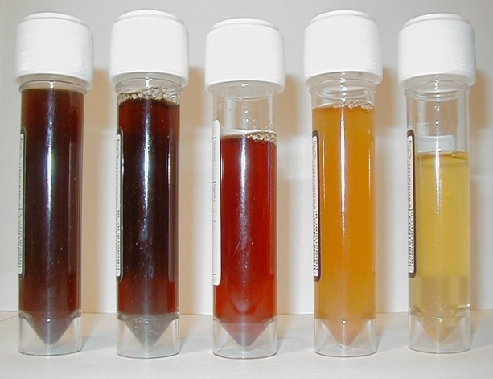
CLINICAL FEATURES OF PNH:
INTRAVASCULAR HEMOLYSIS
1. Intravascular hemolysis
  Absence of CD59 (not CD55) from RBCs is largely responsible for increased sensitivity of RBCs to activated complement and intravascular hemolysis
  Degree of GPI-deficiency is variable:
    Type I RBCs: normal GPI expression
    Type II RBCs: partial GPI expression
    Type III RBCs: no GPI expression
The greater the percentage of Type III cells, the greater the intravascular hemolysis: RBC lifespan drops to <20 days
Caveat: only 25% of patients present with nocturnal hemoglobinuria

Slide 30
CLINICAL FEATURES OF PNH:
THROMBOSIS
2. Thrombotic events (TEs), particularly in unusual sites
40% of PNH patients experience clinical TEs¹
Leading cause of death²
  Accounts for 40–67% of deaths¹
  First TE can be fatal^{1,3}
  Median time to TE was 2.3 years from diagnosis⁴
  First TE increases risk for death 5- to 10-fold¹
1. Hillmen et al., 2007.; 2. Parker C et al., 2005.; 3. Audebert HJ et al., 2005.; 4. de Latour RP, 2008.
Notes:
Key Points:
Thrombosis is a common and frequent cause of death in PNH and is highly underappreciated
40 to 67% patients with PNH die from a TE
The first TE can be fatal and it increases the risk for death 5- to 10-fold
Median time to first TE was 2.1 to 2.3 years from diagnosis

Slide 31
CLINICAL FEATURES OF PNH:
BONE MARROW FAILURE
3. Bone marrow failure
Death from progressive pancytopenias
Progression to other disorders, e.g.:
  Aplastic anemia
    Most PNH patients have hypoplastic marrow
  Myelodyplastic syndromes
    8-year incidence of 5%
  Acute leukemia
    8-year incidence of 0.7%

Slide 32
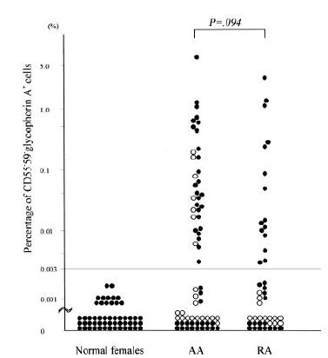
WHAT DOES PNH HAVE TO DO WITH APLASTIC ANEMIA AND MDS?
Distribution of PNH-type granulocytes in patients with AA or RA¹
Aplastic anemia (AA)
Most PNH patients have hypoplastic marrow and many have AA or a history of AA
50% of AA patients exhibit expansion of PNH clones (15% reach clinical PNH)
Myelodysplastic syndromes (MDS)
20% of MDS patients have PNH clones (refractory anemia [RA] may respond to immunosuppressive therapy)
Copyright © 2003 American Society of Hematology. Reprinted with permission.
1. Ishiyama K et al., 2003.

Slide 33
OTHER CLINICAL FEATURES OF PNH
Key/classic features:
Intravascular hemolysis
Thrombotic events (particularly in unusual sites)
Bone marrow failure
Other important features:
Renal dysfunction/failure
Pulmonary hypertension
Abdominal and/or chest pain
Erectile dysfunction
Impaired quality of life

Slide 34

KIDNEY DISEASE IN PNH
Renal function impaired in PNH patients¹
  13/19 (68%) with significant reduction in CrCl
  6/19 (32%) GFR <60 ml/min/1.73m² (Stage 3 CKD)
Renal failure is the cause of death in 8–18% of PNH patients^{2,3}
59% of patients with minimal (0–1) transfusion history had CKD (n=22)
1. . Clark DA et al. Blood. 1981 Jan;57(1):83-9. 2.Nishimura JI, et al. Medicine. 2004;83:193-207. 3. Hillmen P et al. Am. J. Hematol. 2010; 85:553–559.
Notes:
KEY POINTS:
Kidney disease is an underappreciated cause of mortality in PNH
In a study of 21 PNH patients (Clark 1981), it was found that
68% of patients had a significant reduction in creatinine clearance
32% had a GFR <60
34

Slide 35
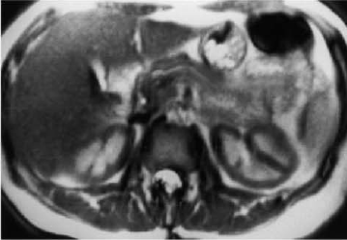
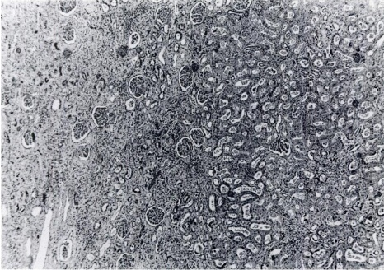
KIDNEY DISEASE IN PNH:
MECHANISMS
PNH and renal failure.
T2-weighted images show low signal intensity (dark) renal cortex, reflecting hemosiderin deposition
Renal biopsy showing interstitial scarring (on the left)
Free hemoglobin is nephrotoxic
80% have renal hemosiderosis (autopsy/biopsy, MRI)
Interstitial nephritis/fibrosis (autopsy/biopsy)
Thrombi/infarcts detectable in nearly 100%

Slide 36
DYSPNEA AND
PULMONARY HYPERTENSION IN PNH
NO depletion leads to pulmonary hypertension^{1,2}
  47% of PNH patients have pulmonary hypertension³
  Clinically significant³
66% of PNH patients report dyspnea⁴
Improvement in dyspnea is associated with
  A reduction in LDH and NO consumption²
  No change in hemoglobin²
  A reduction in NT-proBNP²
36
1. Rother R et al. JAMA. 2005; 293: 1653-1662. 2. Hill A et al. Br J Haematol. 2010; May;149(3):414-25. 3. Hill A et al. Br J Haematol. 2006;133 (suppl 1):119: Abstract 316. 4. Meyers G et al. Blood. 2007;110(11): Abstract :3683.
Notes:
36
KEY POINTS:
Dyspnea is common in PNH and is linked to pulmonary hypertension
Improvement in dyspnea is linked to improvement in hemolysis and a reduction in NO consumption
Dyspnea improves without a corresponding improvement in Hgb – dyspnea in PNH is not caused by anemia
Improvement in dyspnea is associated with a change in pro-BNP a marker for PHT

Slide 37
SUPPORTIVE CARE FOR PNH-RELATED SYMPTOMS
Supportive treatment for PNH-associated anemia
and thrombosis:
RBC transfusion
Iron supplementation
Folic acid supplementation
Anticoagulant therapy (most commonly warfarin)
Corticosteroids with or without androgen therapy

Slide 38
BONE MARROW TRANSPLANTATION FOR MANAGEMENT OF PNH
BMT is associated with significant morbidity and mortality
Early experience not encouraging
International Bone Marrow Transplant Registry (IBMTR)
  56% 2-year survival (n=48 HLA-identical sibling transplants)
  14% 5-year survival of allogeneic transplants
  33% chronic graft vs. host disease (1999)
HLA = human leukocyte antigen.

Slide 39
EBMT EXPERIENCE: CONCLUSIONS
Current indications for SCT should be challenged
PNH with TE: SCT not standard of care
Hemolytic PNH: SCT may be valuable for if eculizumab is not available
PNH/AA: SCT or IST
Peffault de Latour et al., Haematologica, 2012

Slide 40
BONE MARROW TRANSPLANTATION FOR PNH: CASE SELECTION
PNH (>10%) and SAA
Main problem:
Hemolysis
(anemia, thrombosis, symptoms)
Main problem:
Pancytopenia
Eculizumab
Allo-SCT
ATG/CsA
…and monitor the clone!

Slide 41
SOLIRIS® (ECULIZUMAB): HUMANIZED, FIRST-IN-CLASS ANTI-C5 ANTIBODY
Human Framework Regions
No mutations
Germline
CH1
Hinge
CL
Complementarity determining regions
(murine origin)
CH2
Human IgG₂ heavy chain
Constant Region 1 and hinge
(eliminates Fc receptor binding)
Human IgG₄ heavy chain
Constant Regions 2 and 3
(eliminates complement activation)
CH3
IgG = immunoglobulin G.
Soliris® (eculizumab) Product Monograph, 2013.; Rother R et al., 2007.
Notes:
Key Points:
Soliris® is a first-in-class humanized anti-C5 monoclonal antibody
Soliris® has very high affinity for binding to human C5 protein; each Soliris® molecule binds two C5 proteins
Soliris® is the first therapy to specifically target complement-mediated hemolysis
Soliris® is unique among humanized monoclonal antibodies because germline human framework acceptor sequences were used to minimize immunogenicity
Human IgG2/4 heavy chain constant regions were used to eliminate the ability of the antibody to bind Fc receptors and activate complement

Slide 42
SOLIRIS® REIMBURSEMENT IN PNH
Across Canada, Soliris® may be reimbursed based on standardized criteria:
Confirmed diagnosis of PNH, based on flow cytometry/FLAER assay with granulocyte clone ≥ 10 % and LDH > 1.5 ULN, and
At least one of the following clinical conditions:
  A thrombotic or embolic event which required anticoagulant therapy
  Transfusion of at least 4 units of red blood cells in the last 12 months
  Chronic or recurrent anemia (more than one measure of Hb ≤ 70 g/L or of Hb ≤100 g/L with concurrent symptoms of anemia) where causes other than hemolysis have been excluded
  Pulmonary insufficiency: Shortness of breath and/or chest pain resulting in limitation of normal activity (≥ NYHA class III) and/or diagnosis of pulmonary arterial hypertension, where causes other than PNH have been excluded
  Renal insufficiency: eGFR ≤ 60 mL/min/1.73 m², where causes other than PNH have been excluded
  Smooth muscle spasm: Recurrent episodes of severe pain requiring hospitalization and/or narcotic analgesia, where causes other than PNH have been excluded

Slide 43
ECULIZUMAB: COMPELLING LONG-TERM
CLINICAL BENEFITS IN PNH PATIENTS
Pre-Soliris® from time of
diagnosis in 80 patients with PNH¹
PNH patients on Soliris® compared with
age- and gender-matched controls^{2*}
100
100
80
80
Age- and gender-
matched controls
60
60
Age- and gender-matched
normal population
Patients surviving (%)
Soliris®-treated PNH population
40
40
20
Patients with PNH
20
0
0
0
5
10
15
20
25
0
2
4
6
8
10
Years after diagnosis
Time (years)
Despite best supportive care, 5-year mortality rate was 35%¹
Hazard ratio = 2.24 (p = 0.013)
*Survival after 10 years is slightly inferior to controls with causes of death related to bone marrow failure and not hemolysis or thrombosis.
Copyright © 2012 American Society of Hematology. Reprinted with permission.
.
1. Hillmen P et al., 1995.; 2. Hill A et al., 2012.; 3. Soliris® (eculizumab) Product Monograph, 2013.
Notes:
The data in this slide shows that complement blockade with Soliris® is providing a life-saving benefit to PNH patients. Thus, early and accurate diagnosis of this disease is clearly warranted
The number of patients at risk at 10 years is not provided in the study¹
Reference:
Hill A et al. Presented at the 54th Annual Meeting of the American Society of Hematology (ASH). December 8–11, 2012; Atlanta, Georgia; Abstract #3472.

Slide 44
SOLIRIS® TREATMENT EXPECTATIONS
In 1 week
Reduction in hemolysis (as measured by LDH)¹
Reduction in fatigue¹
Between 2 and 3 weeks
Improvement in quality of life²
Improvement in dyspnea³
Between 2 and 6 months
Reduction in transfusions²
Stabilization of hemoglobin levels²
Improved or maintained chronic kidney disease (CKD)⁴
Reduction in thrombotic event rate⁷
>6 months
Continued improvement in quality of life^{2,5}
Achieved maximum concentration of red blood cells⁴
LDH levels maintained at upper limit of normal¹
At 36 months
Continued reduction in hemolysis
(as measured by LDH) was sustained⁶
Prevention of TE was maintained⁶
Continued improvement of CKD⁶
Most adverse events were mild or moderate in severity⁷
At 8 years
Sustained and well-tolerated efficacy; improved survival⁸
1. Hillmen P et al., 2007.; 2. Hillmen P et al., 2006.; 3. Hill A et al., 2010.; 4. Hillmen P et al., 2010.; 5. Brodsky RA et al., 2008.; 6. Hillmen P
et al. 2013.; 7. Soliris® (eculizumab) Product Monograph, 2013.; 8. Kelly RJ et al., 2011.

Slide 45
SOLIRIS® SAFETY PROFILE
Safety and tolerability confirmed in the long-term (36-month) study, with data up to 66 months
No cumulative toxicity was demonstrated during Soliris® treatment
Significantly fewer patients with adverse events in the last 26 weeks of treatment compared with the first 26 weeks (p<0.001)
91.3% of adverse events were mild to moderate; the most frequent were headache, nasopharyngitis and upper respiratory tract infection
Patients must be vaccinated against Neisseria meningitidis at least
2 weeks prior to starting Soliris®
1. Hillmen P et al., 2013.; 2. Soliris® (eculizumab) Product Monograph, 2013.

Slide 46
What is new in PNH
AXLN 1210 (ravulizumab) demonstrated to be noninferior to eculizamab and is health Canada approved now AWAITING funding agreements
Advantage Given q 8 weeks with improved quality of life
Other C5 inhibitors subcutaneous, oral : ALL in ClinicalTrials
C3 inhibitors Apellis product sq twice a week Promising especially for c3 loaders
Factor D inhibition Achillion

Slide 47
Thank you for your attention
Questions??

