Slide 1
Treatment of Aplastic Anemia and Paroxysmal Nocturnal Hemoglobinuria
Dr. M. Sabloff
Director of the Leukemia Program at the Ottawa Hospital
October 13th 2018

Slide 2
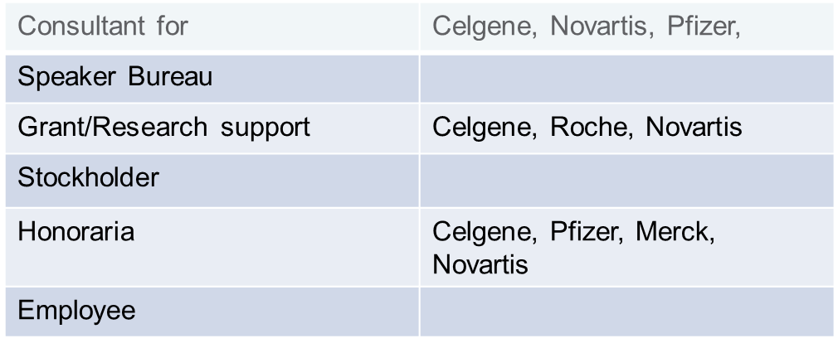
Disclosures

Slide 3
Objectives
Aplastic anemia
  Epidemiology
  Treatment options
PNH
  Epidemiology
  Treatment
Future Trends

Slide 4
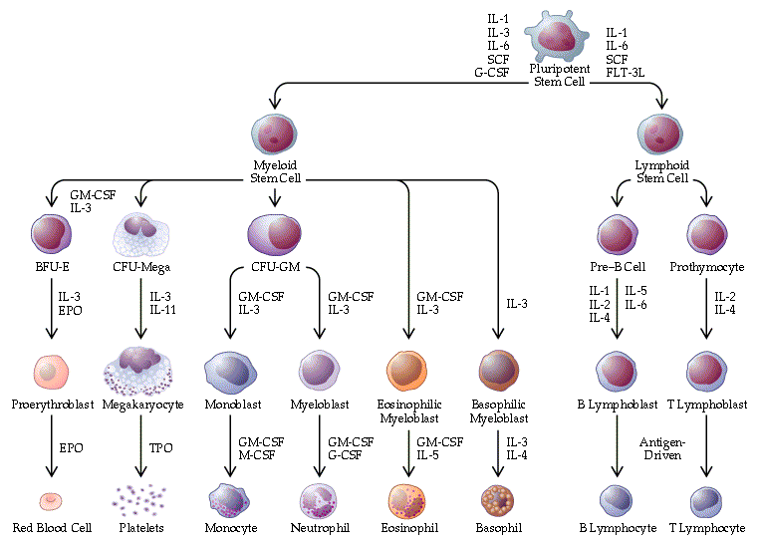
Normal hematopoiesis

Slide 5
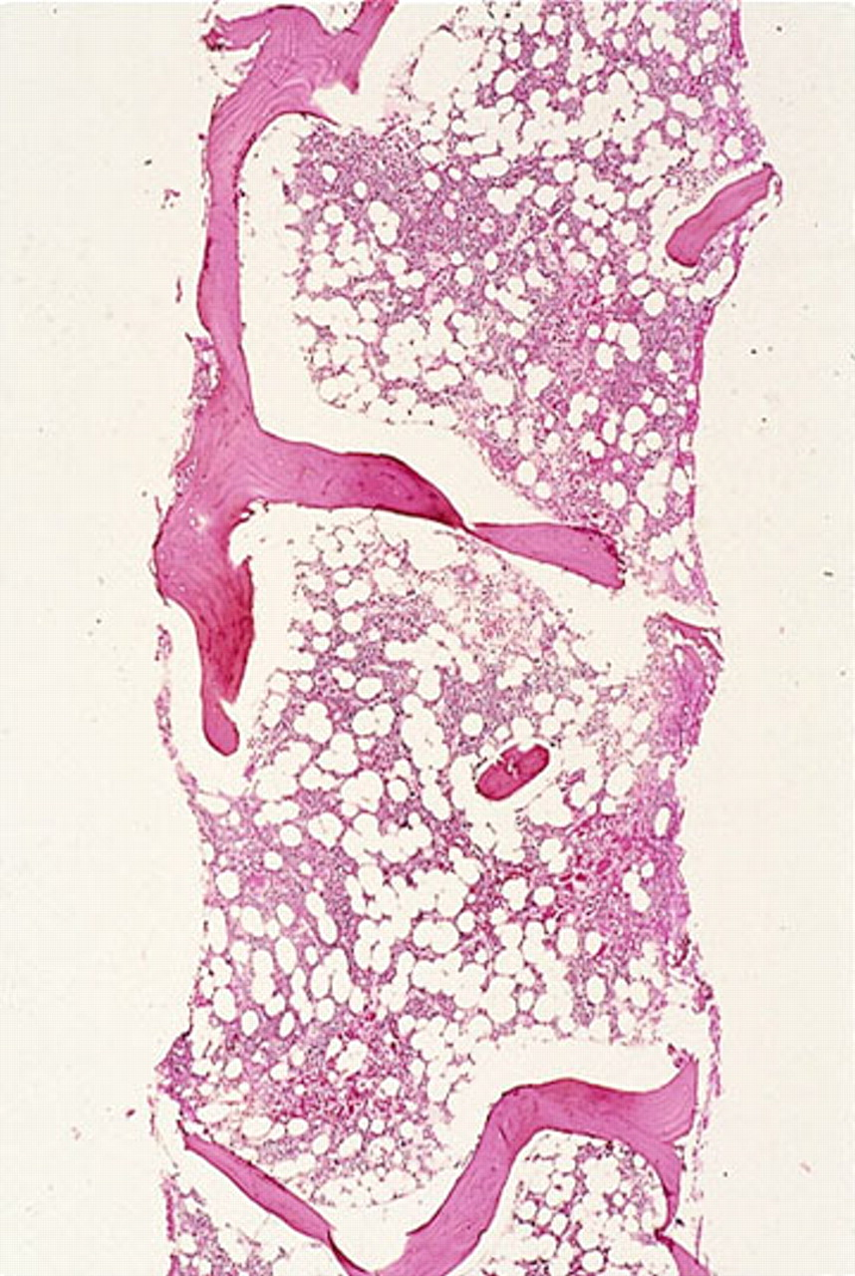
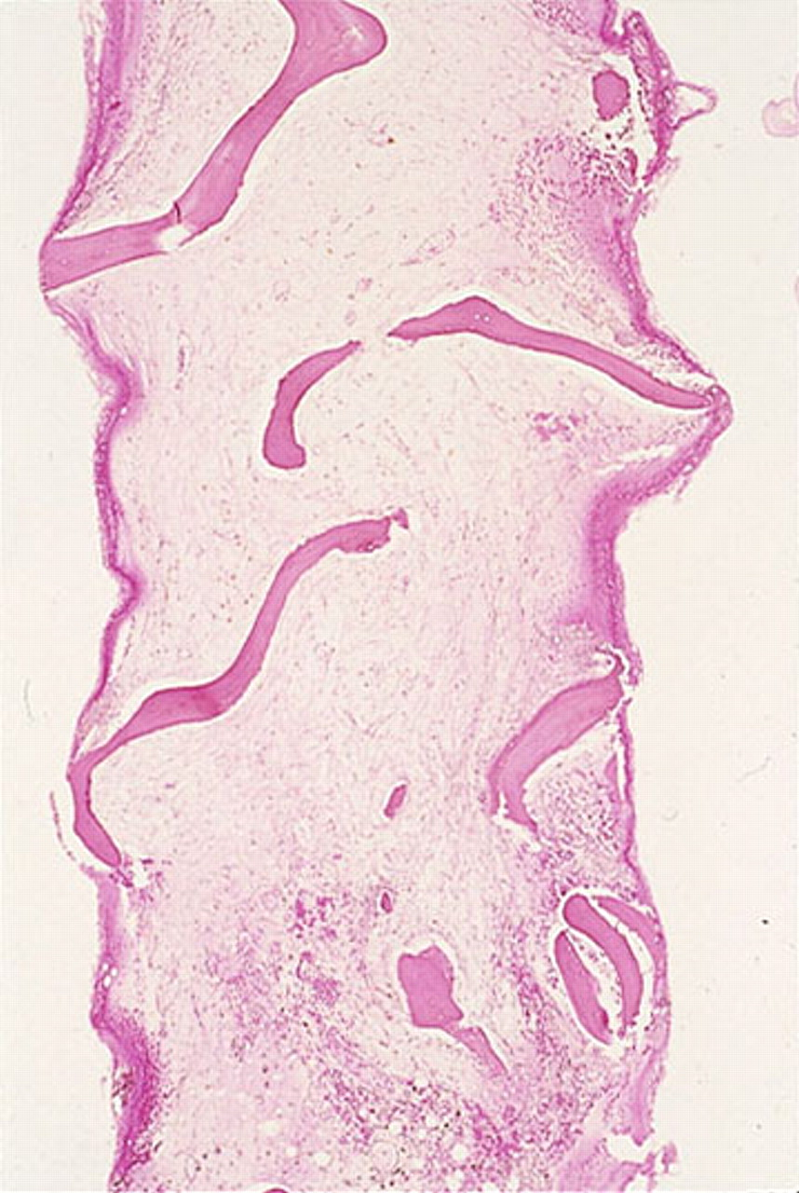
Bone marrow failure
Normal Bone Marrow
Bone Marrow Failure
ASH Image Bank

Slide 6
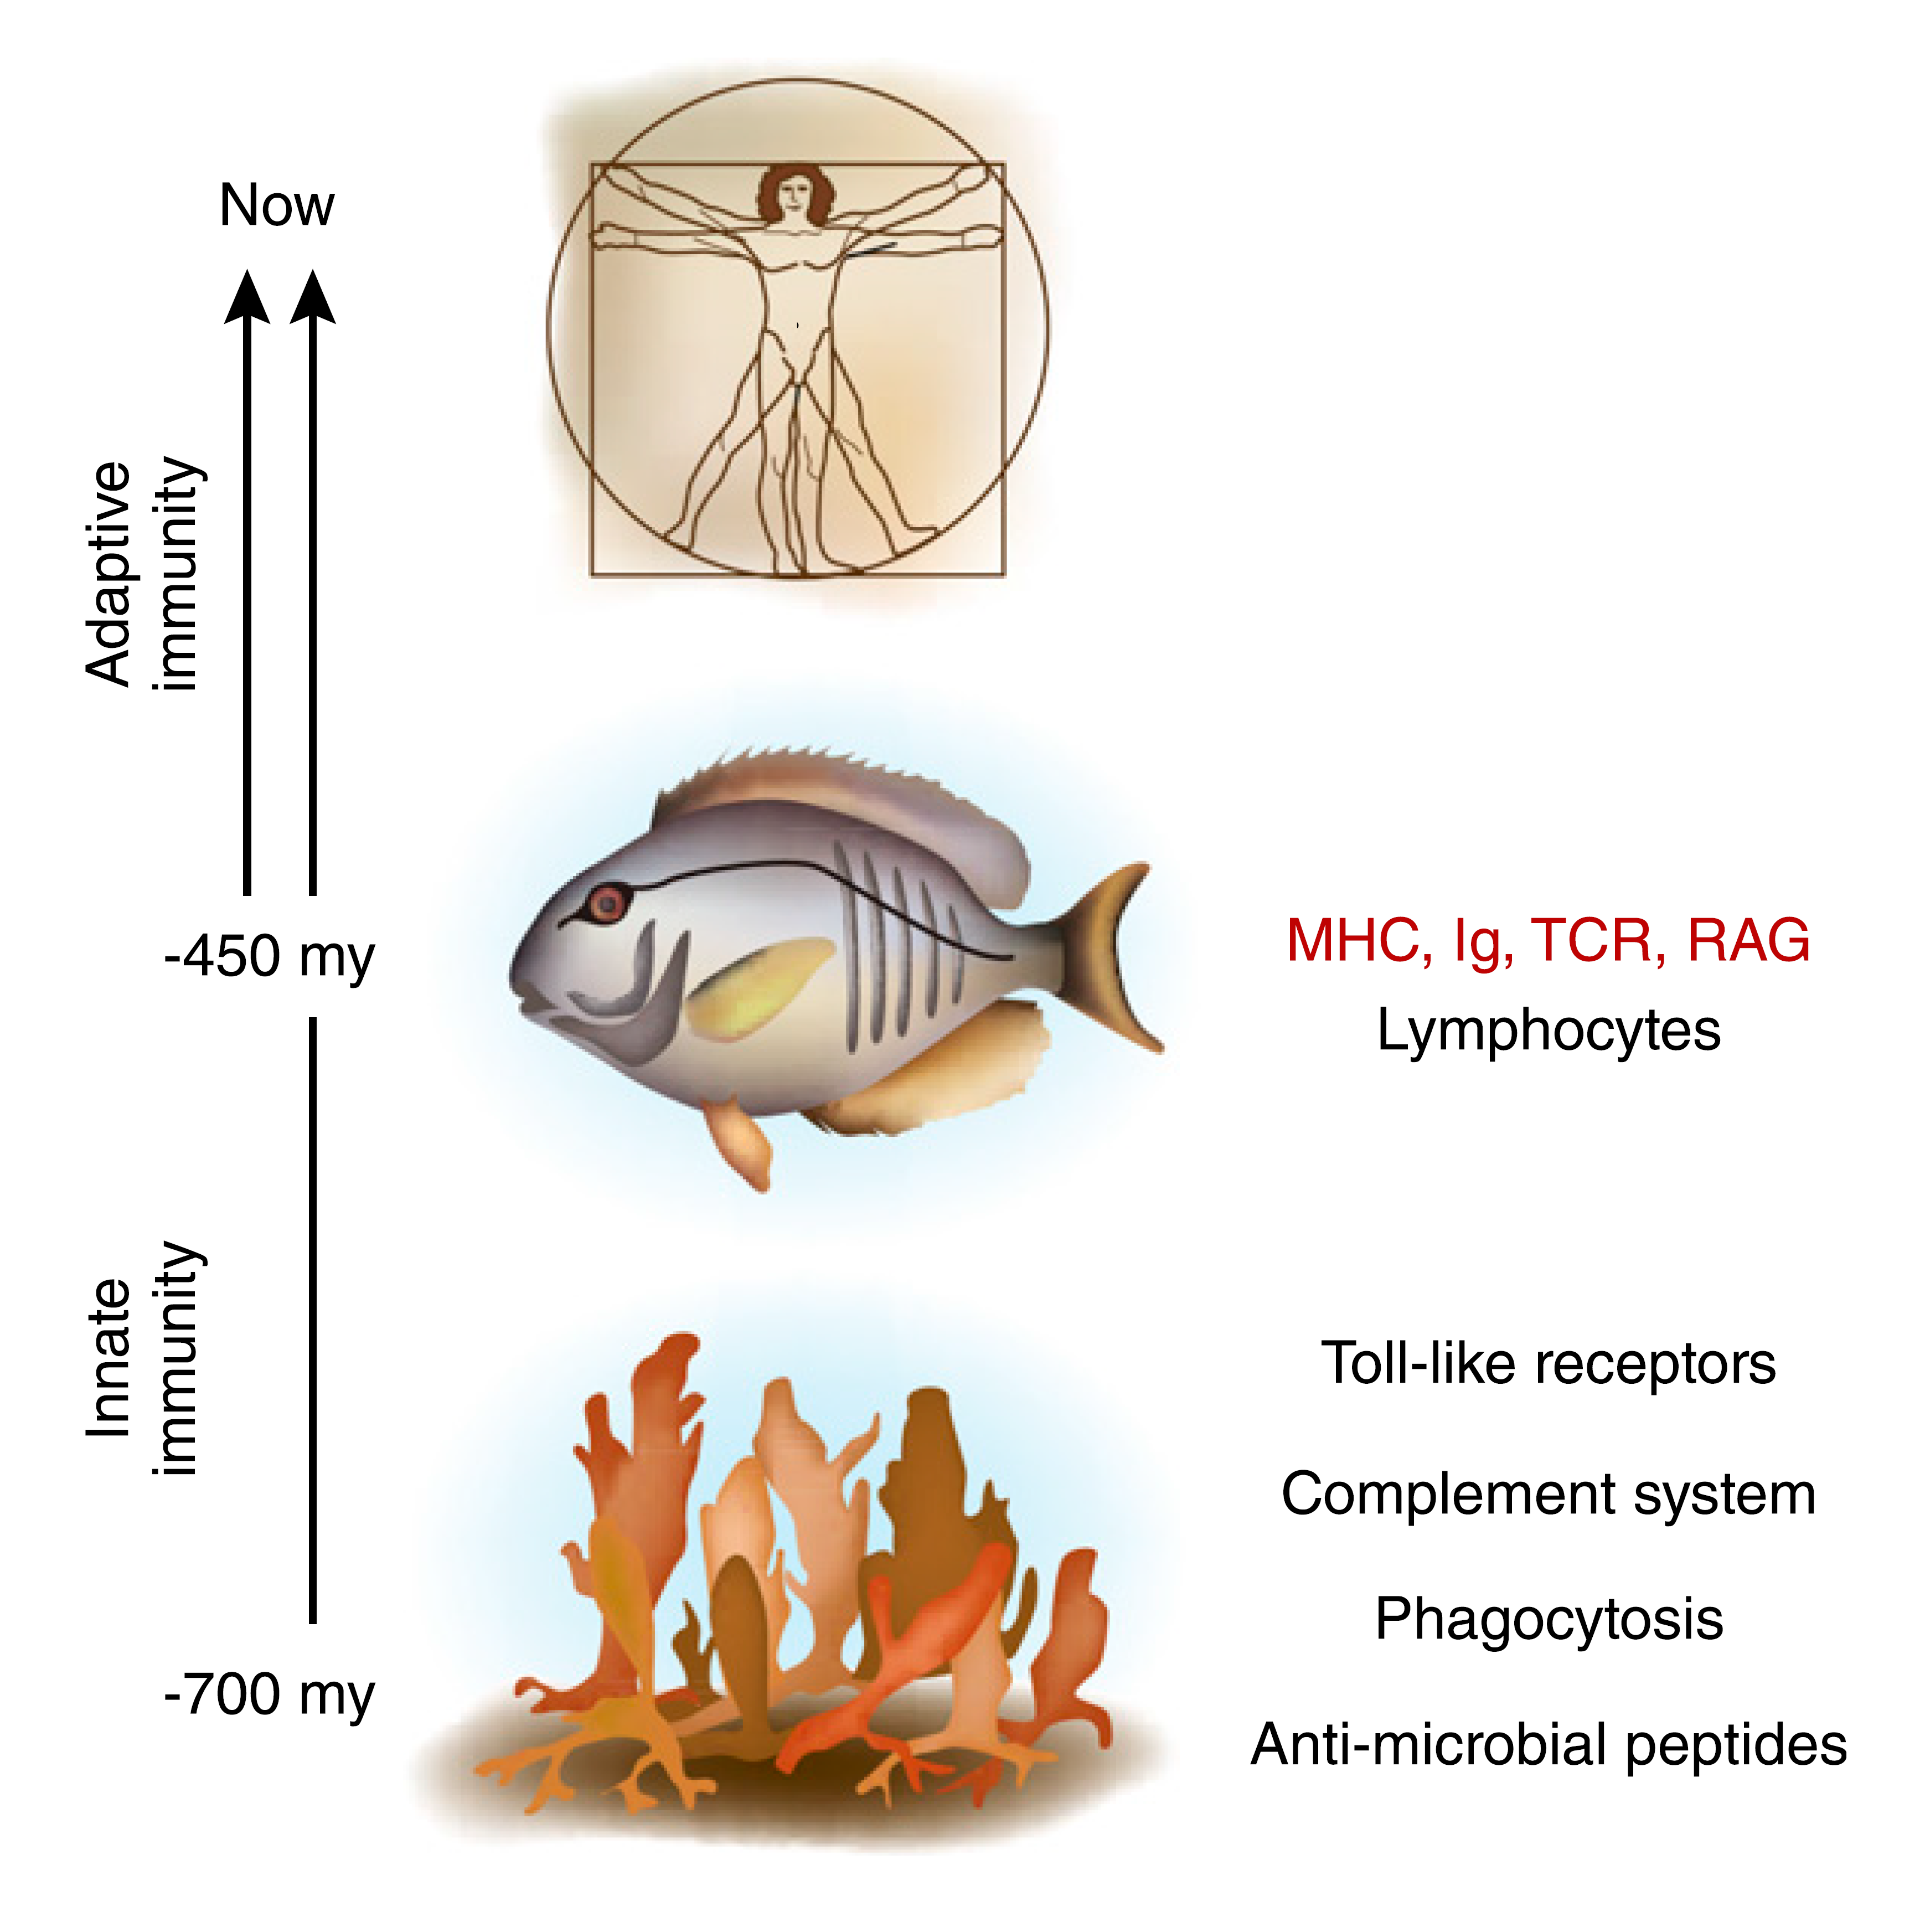
Immune systems
innate immune system
Oldest and most basic
immediate but incomplete protection
Short-term memory
sluggish
  Complement system
  Toll-like receptors
  phagocytic cells

Slide 7
Immune systems
Adaptive immunity
recognize nonself
Exquisite specificity
  product of gene recombination
generates a very large number of unique antigen receptors
  B and T lymphocytes
Upon encountering antigens
  lymphocytes proliferate
  B lymphocytes transform into antibody factories known as plasma cells
  T lymphocytes differentiate into helper and effector (e.g., cytotoxic) subsets
  secrete molecules (cytokines).
Helper T lymphocyte orchestrate the mounting immune response
cytotoxic T lymphocytes directly effect the death of cells
Memory cells
Yatim KM. Clin J Am Soc Nephrol (2015)10: 1274

Slide 9
Bone marrow failure - epidemiology
Paul Ehrlich first noted in 1888
Incidence: 2-3/million/year
  3x in Asian population
Median age 20 year old
Rarely associated with
  Environmental exposures
  Medications/chemicals
  Pregnancy
  HIV or hepatitis

Slide 10
Bone marrow failure – Signs and symptoms
Fevers
Different types of infections
Bleeding
Fatigue
Paleness
Classification
  Non-severe
  Severe
  Very severe

Slide 11
Aplastic Anemia non-severe
May not need any therapy
Monitor for symptoms
Transfuse blood or platelets as needed
Look for associated disorders
  i.e. PNH, MDS,
Look for any exacerbating factors
  Vitamins deficiencies
  Infections – Virus
  Medications
Specific therapy
  Immune- suppression

Slide 12
Aplastic Anemia severe or very severe
Always requires therapy
Minimize Exacerbating factors
Look for associated disorders
  i.e. PNH, MDS,
Specific therapy
  Stem cell transplant
  Immune suppression

Slide 13
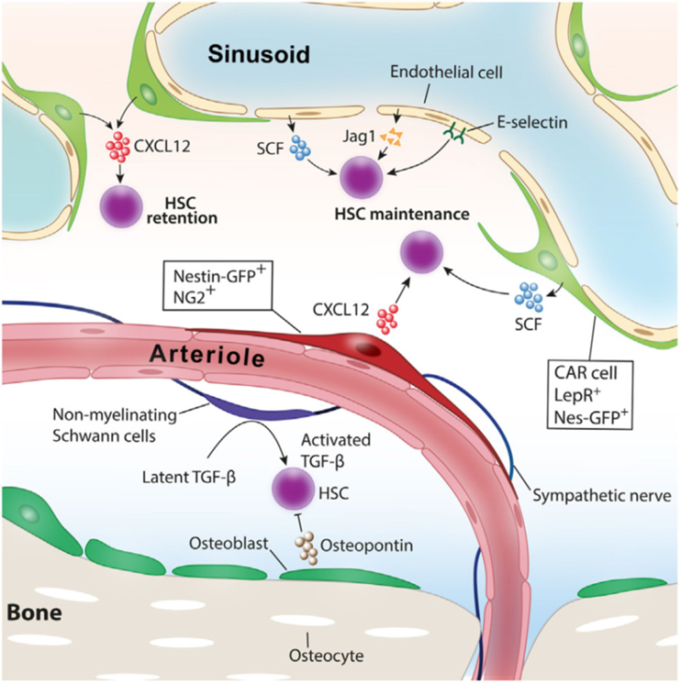
Normal bone marrow niche

Slide 14
Aplastic anemia – what is wrong
Disorder of immune factors
  Chemical known as cytokines and
  Cells that regulate immune system
  Twin transplants require immunosuppression pretransplant to allow engraftment

Slide 15
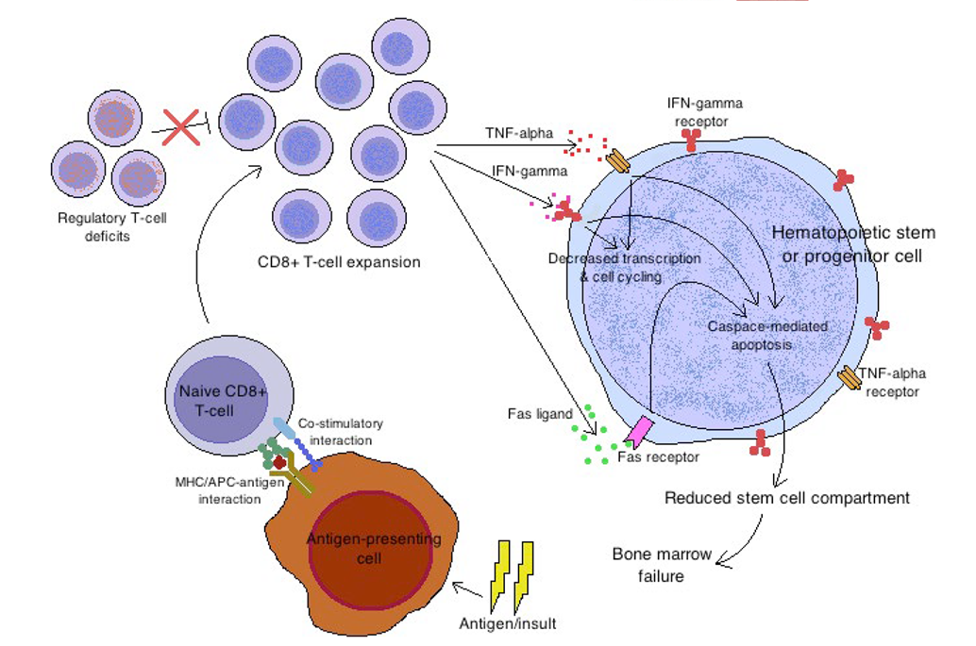

Slide 16
Aplastic anemia – mechanisms?
Telomeres
  Ends of chromosomes
  Shorten with age
  Appear shorter in 35% AA patients
  Some are related to hereditary conditions
  But many are not
  Degree of shortening correlates with severity, risk of relapse, survival and clonal evolution

Slide 17
Treatment of aplastic anemia
After rule out other treatable conditions
Choice of
  Allogenic cell transplant
  Immunosuppression

Slide 18
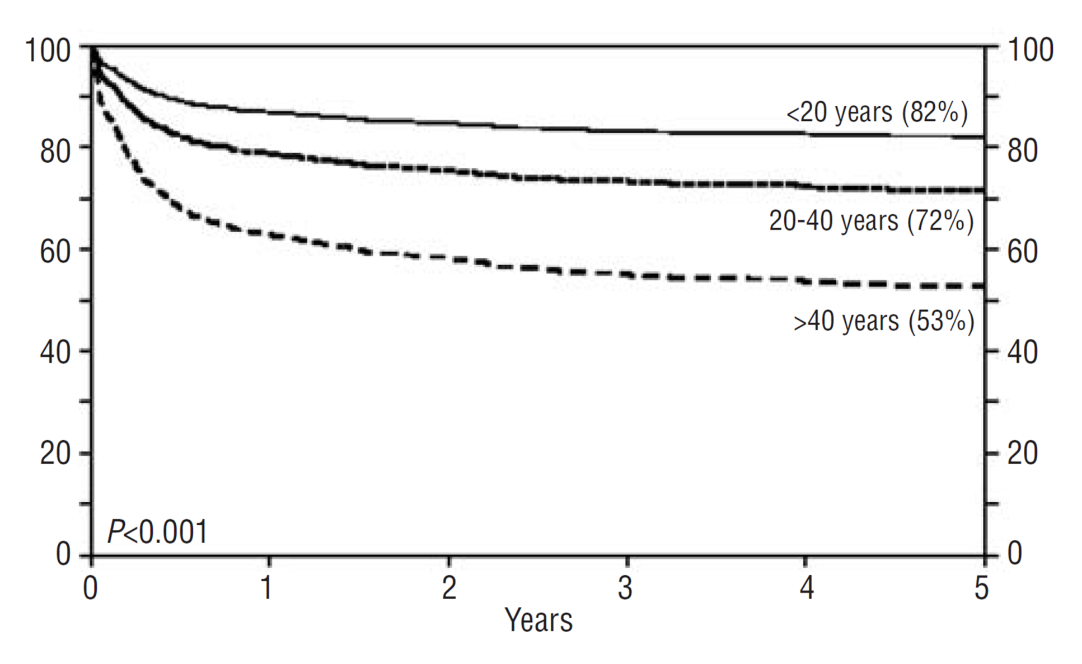
Stem cell transplant for AA
Replace the blood and immune cells with a donor’s
Curative in large proportion from matched donor
Limited to age <40
Complicated by graft vs host disease 20-40%
Gupta V. Haematologica 2010;95(12);2

Slide 19
Immune-suppression:
Cyclosporin
Blocks signals in T-lymphocytes
Dampening or interfering with their immune response.
Failure of treatment
20-30% relapse
Survival
Marsh J Blood (1999) 93(7);2191

Slide 20
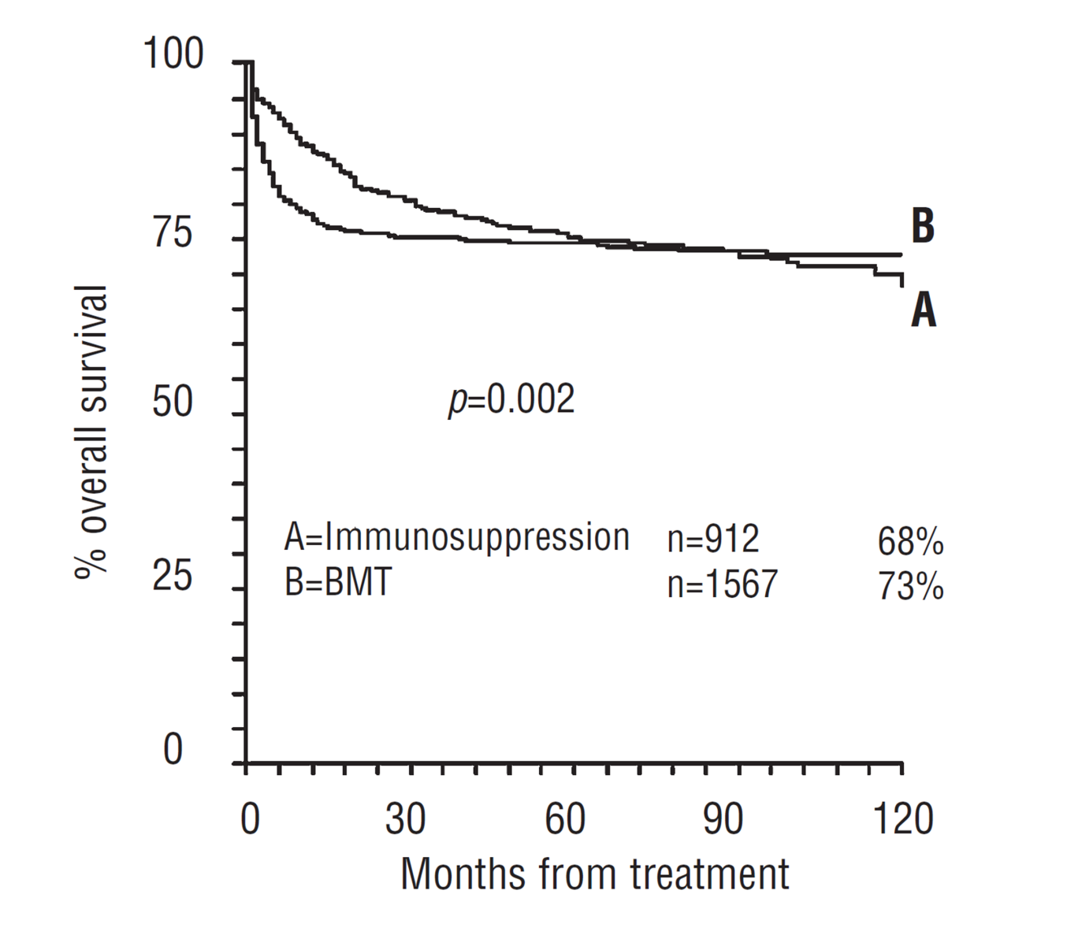
BMT vs. IST
Median age
= 23 (1 – 94)
= 19 (1 – 67)
Locasciulli A. Haematologica 2007 92:11

Slide 21
Paroxysmal nocturnal hemoglobinuria

Slide 22
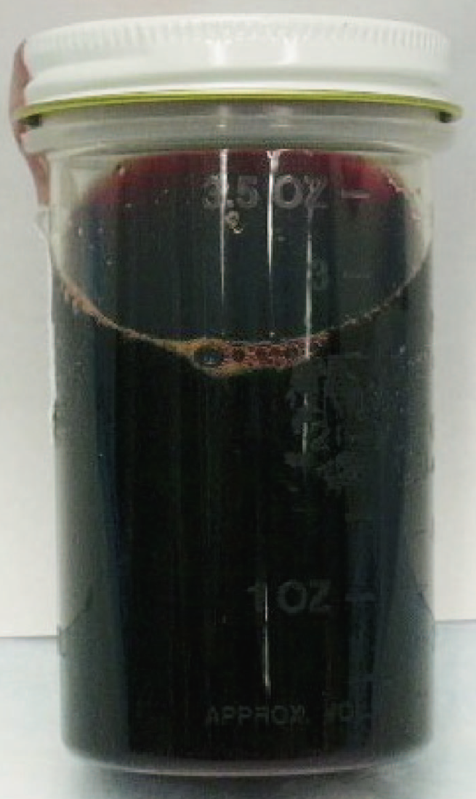
Paroxysmal Nocturnal Hemoglobinuria
Frequency: 1-2/million/year
Median age: 40
Median survival 10-15 years
affect all cells
  Erythrocytes
  Leukocytes
  Thrombocytes
Loss of function of
  the phosphatidylinositol glycan class A (PIG-A)

Slide 23
PNH - some history
1882 – first description by Dr. Paul Strubing
  29-year-old with fatigue, abdominal pain, and severe episodes of dark urine at night (nocturnal paroxysms of hemoglobinuria)
1925 term paroxysmal nocturnal hemoglobinuria introduced
1938 – Ham’s test developed
  Dr. Thomas Hale Ham and Co. discovered that the red cells were more fragile in an acidic environment
1954 alternate pathway of complement activation described

Slide 24
PNH some history
1967 – Dr. William Dameshek
  proposed that PNH, aplastic anemia, and acute leukemia were related
  bone marrow injury might be initiating event
1980s GPI anchors were missing
  2 GPI proteins CD55 and CD59 regulators of the complement system
2004 Dr. Hillmen and Co. published
  Eculizumab demonstrated effective

Slide 25
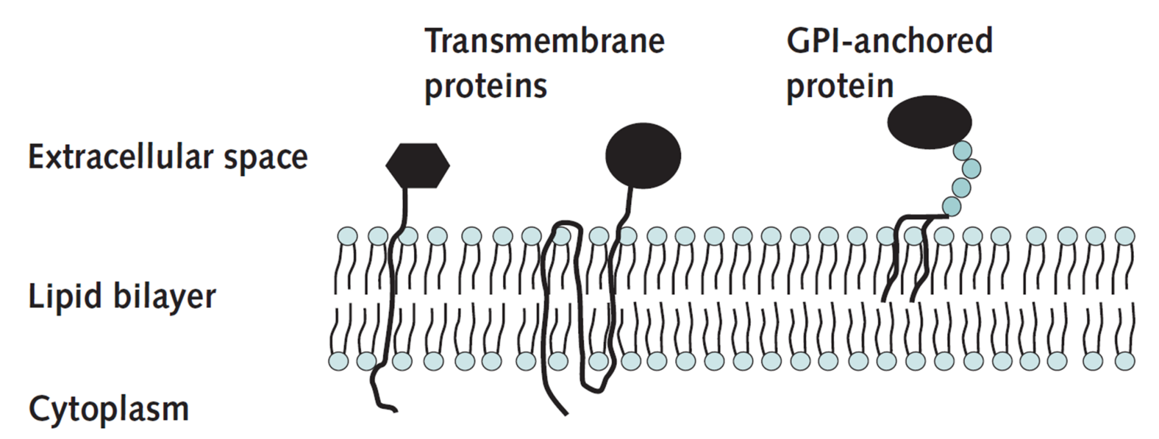
PNH - Etiology
Mutated PIGA gene
PIGA essential for synthesis of a membrane anchor of many proteins
Red cells have many proteins on its surface
Many are linked through GPI anchor
Brodsky RA. (2008) Ann Intern Med 148;587

Slide 26
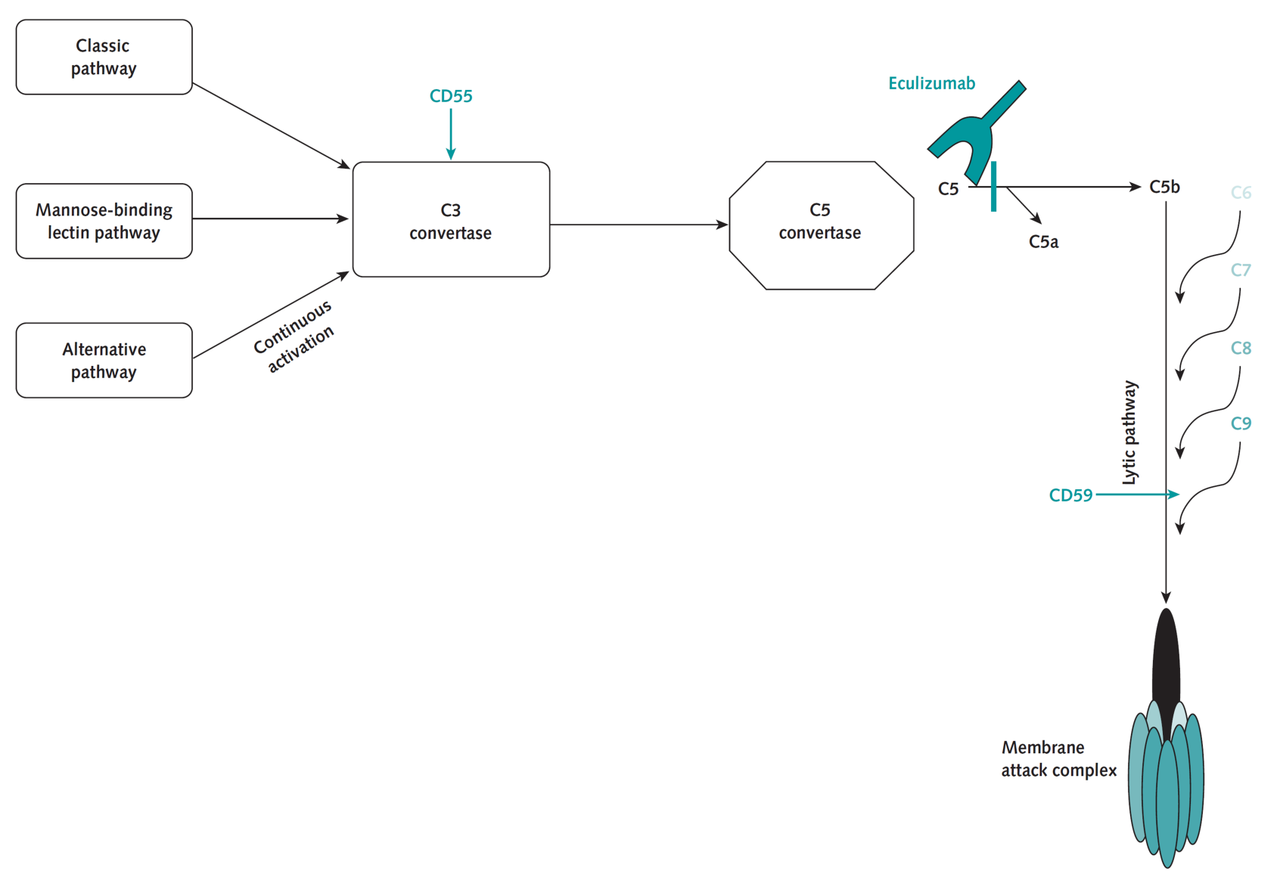
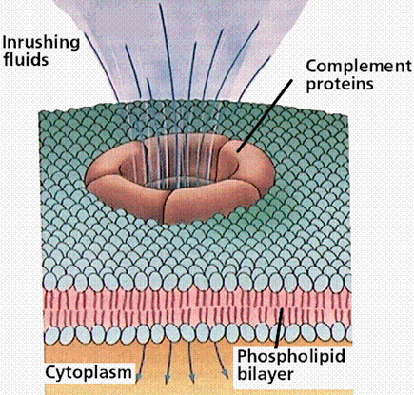
PNH- etiology
Uncontrolled complement activation

Slide 27
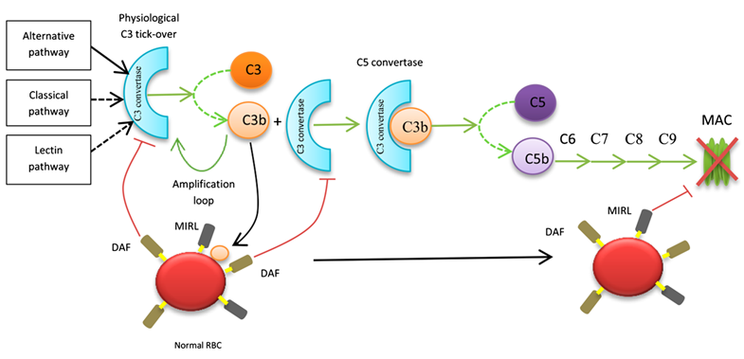
Complement system - normal
Devalet B. EUR J Hem (2015) 95;190

Slide 28
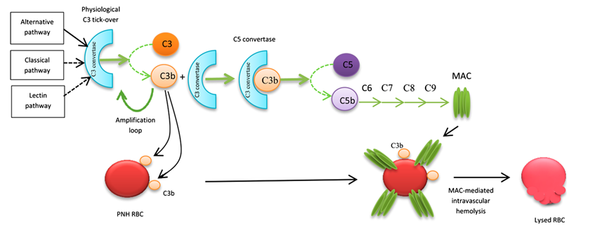
Complement system - pnh

Slide 29
Presenting symptoms
Classic
  Hemolysis
  Thromboembolic phenomenon
  Bone marrow failure
    Fatigue, dysphagia, abdominal pain,
    dyspnea, dark urine, and erectile dysfunction
CATCH
  Cytopenias,
  Aplastic anemia/myelodysplasia,
  Thrombosis
  Coombs’-negative hemolysis
  Hemoglobinuria

Slide 30
Etiology of symptoms
The problem is the release of depletion of NITRIC OXIDE
What is NITRIC OXIDE?
NITRIC OXIDE
  Free radical
  1998 Nobel Prize in Physiology or Medicine was awarded for discovering nitric oxide's role as a cardiovascular signalling molecule
  Relaxes smooth muscle
  Dilates blood vessels
  Viagra works by releasing more NITRIC OXIDE
Release of hemoglobin decreases NITRIC OXIDE

Slide 31
How do these abnormal cells survive over normal cells (2 step mechanism)
PIG-A mutation
Expansion
  Usually start off in a small population
  “attack” on the bone marrow by T-cells
  Normal cells are destroyed
  PIG-A mutated cells survive and thrive

Slide 32
diagnosis
Ham test
Sucrose test
flow cytometry

Slide 33
PNH
Symptomatic treatment
low blood counts
  Transfusions
  Folic acid
  Treat underlying cause
    Hemolysis
    Bone marrow failure
thrombosis
  Anticoagulation

Slide 34
Specific therapies
Hemolysis
  Steroids
  Androgens
  Eculizumab
Bone marrow failure
  Immune suppression
  Stem cell transplant

Slide 35
Marrow Failure
Immune therapy
Similar approach to AA
Higher responders to immune therapy than those without PNH clone

Slide 36
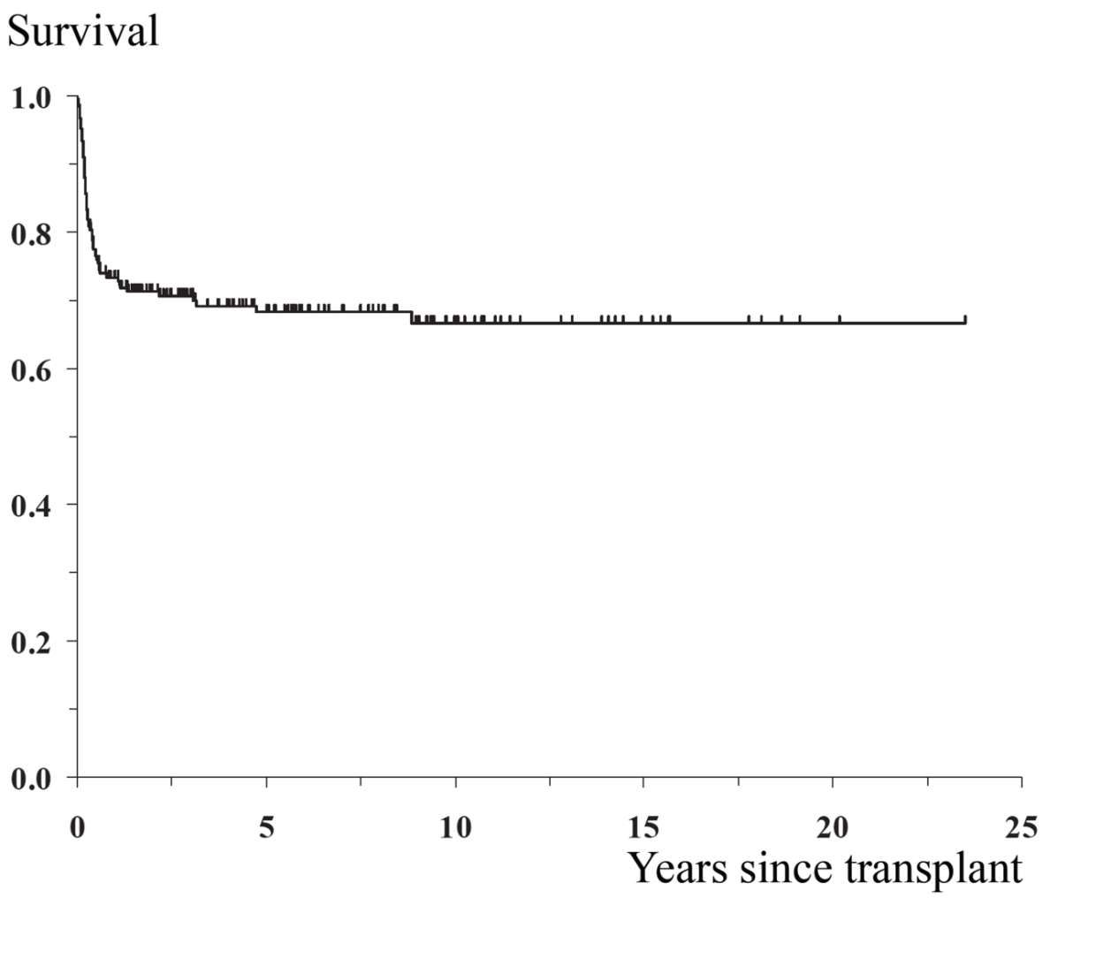
Bone marrow transplant
N=211
Peffault de Latour R. Haematologica (2012) Epub

Slide 37
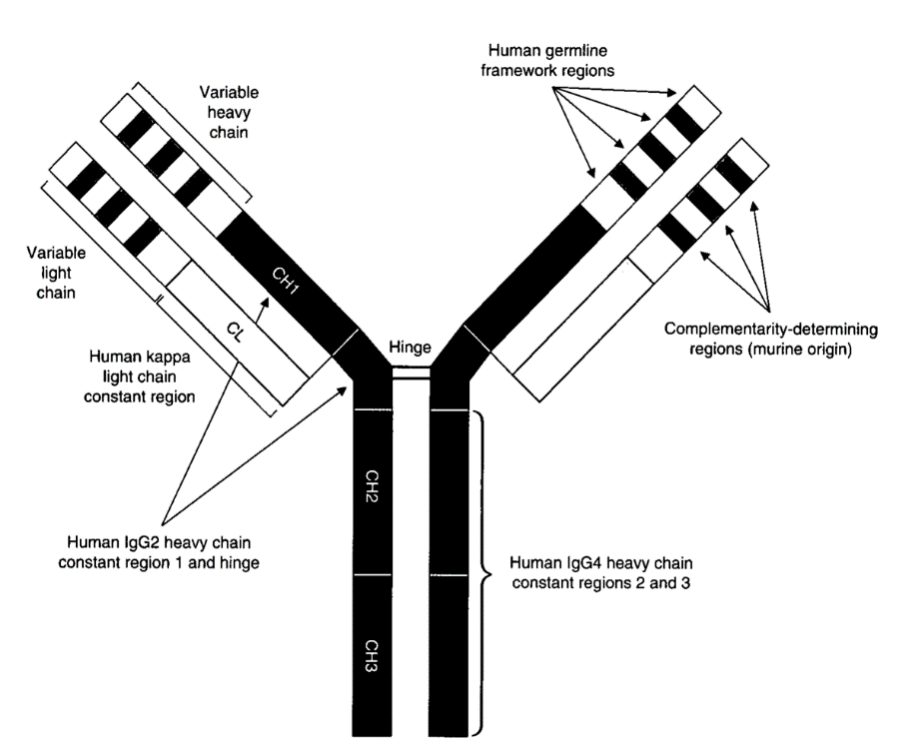
Eculizumab
Antibody targeted to C5
Reduces rate of hemolysis and transfusions
Cautions
  Headaches
  Neisseria infections
  Effective for hemolysis (classic PNH)
  Expensive
  Therapy is lifelong

Slide 38


Slide 39
Eculizumab
Based on work over a decade prior
2006 TRIUMPH study
  Randomized study
  Reduced hemolysis
  Reduced transfusion requirements
  Improved fatigue
2008 SHEPHERD study
  Evaluated long-term safety and efficacy
  Not randomized
  Less stringent entry criteria
Hillmen P. (2006) NEJM 355;12
Brodsky RA. (2008) Blood 11;1840

Slide 40
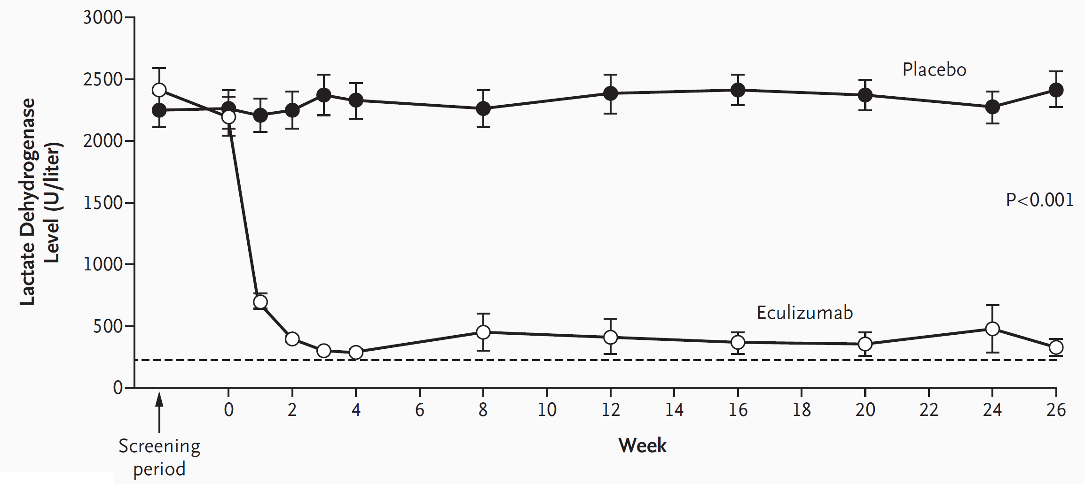
TRIUMPH – results - LD

Slide 41
TRIUMPH – results – time to need for first transfusion.

Slide 42
TRIUMPH – results - FATIGUE

Slide 43
thrombosis
40% incidence
Rate reduced significantly on eculizumab
5.6 compared to 0.8 events/100 patient years

Slide 44
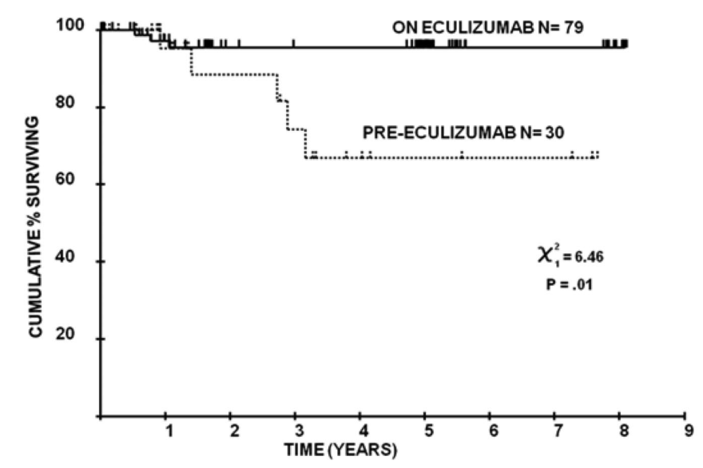
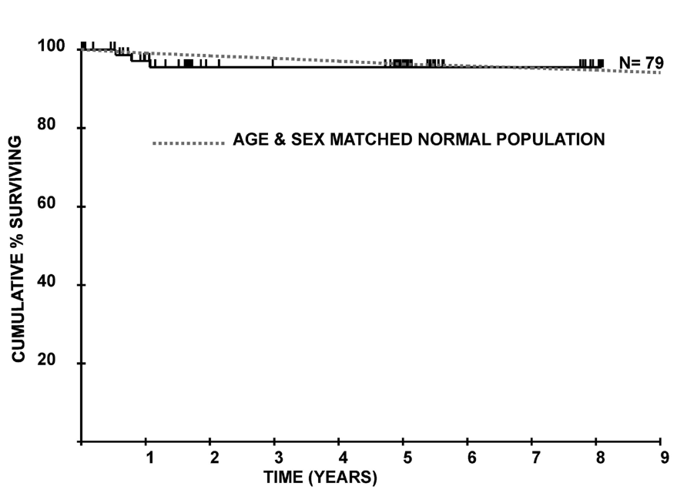
Long-term survival
Kelly RJ Blood (2011) 117;6786

Slide 45
Future trends

Slide 46
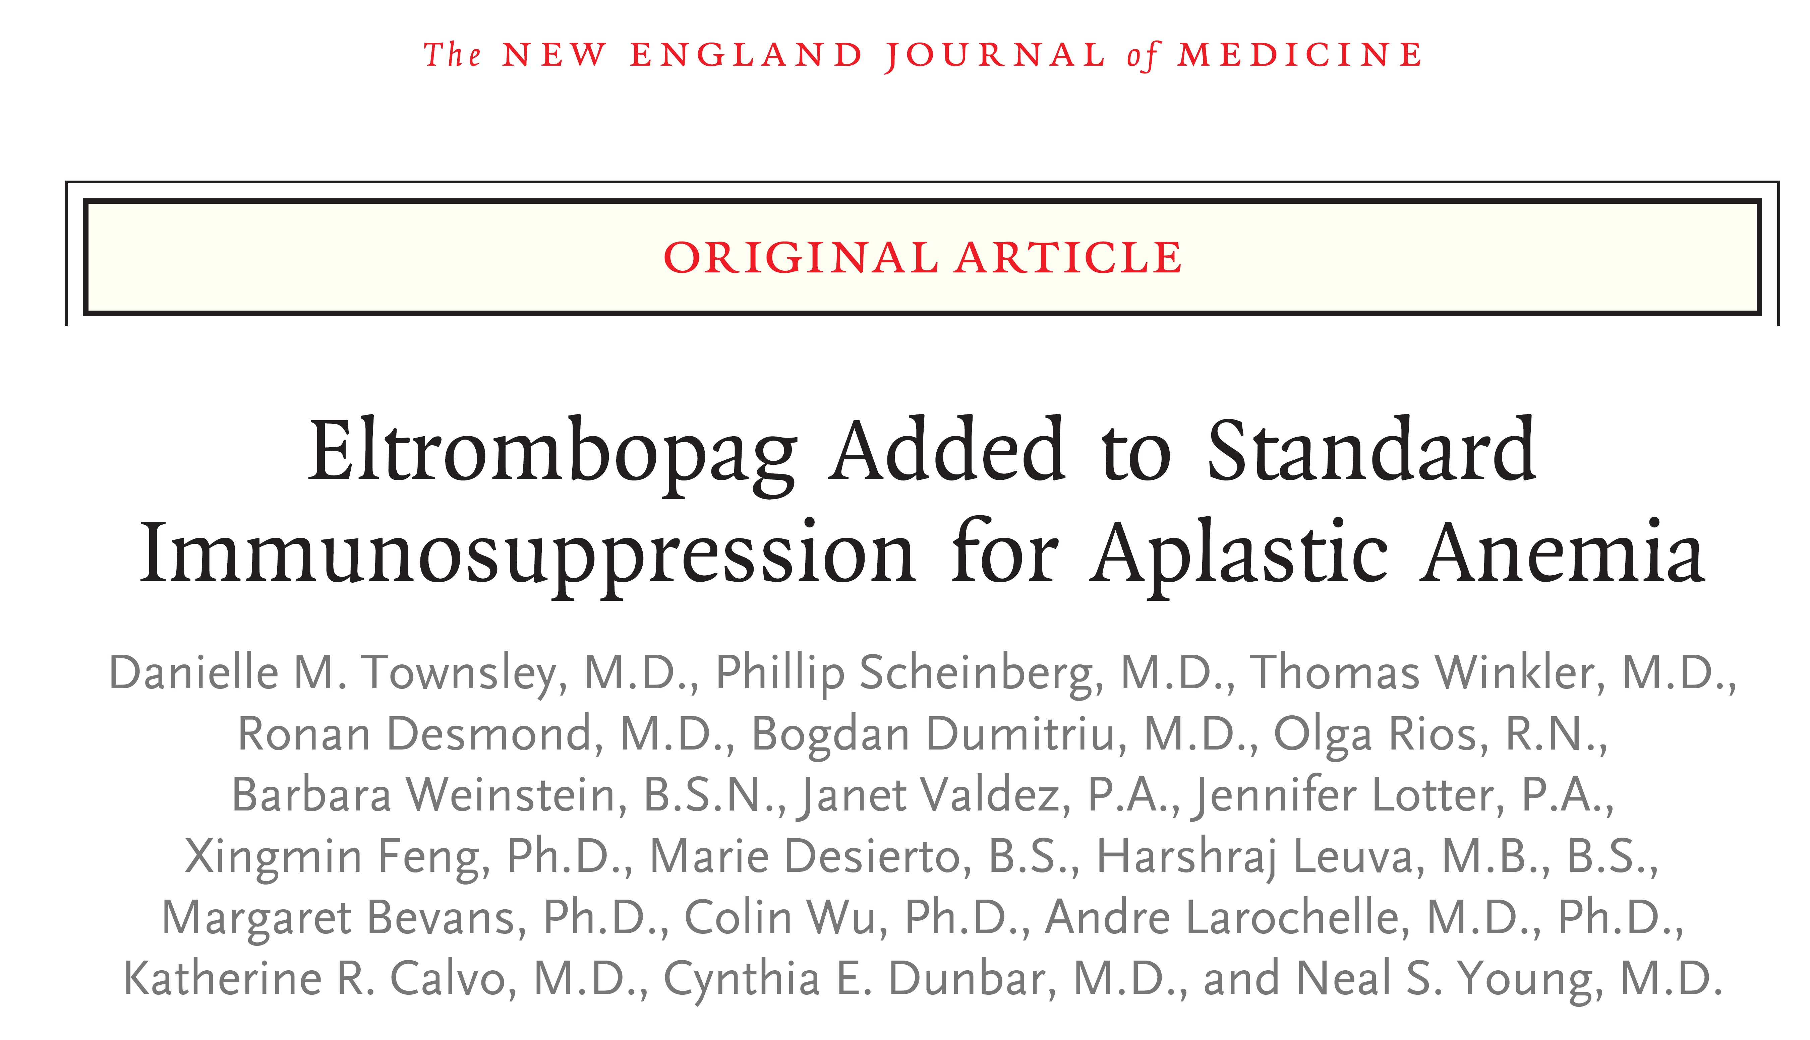

Slide 47
Aplastic anemia – future trends
Eltrombopag
  Molecule stimulating the growth of megakaryocytes
  Was used to boost platelet counts
  Found that it also raised hemoglobin and neutrophil counts in some
  45% patients failing IST may respond to single agent

Slide 48
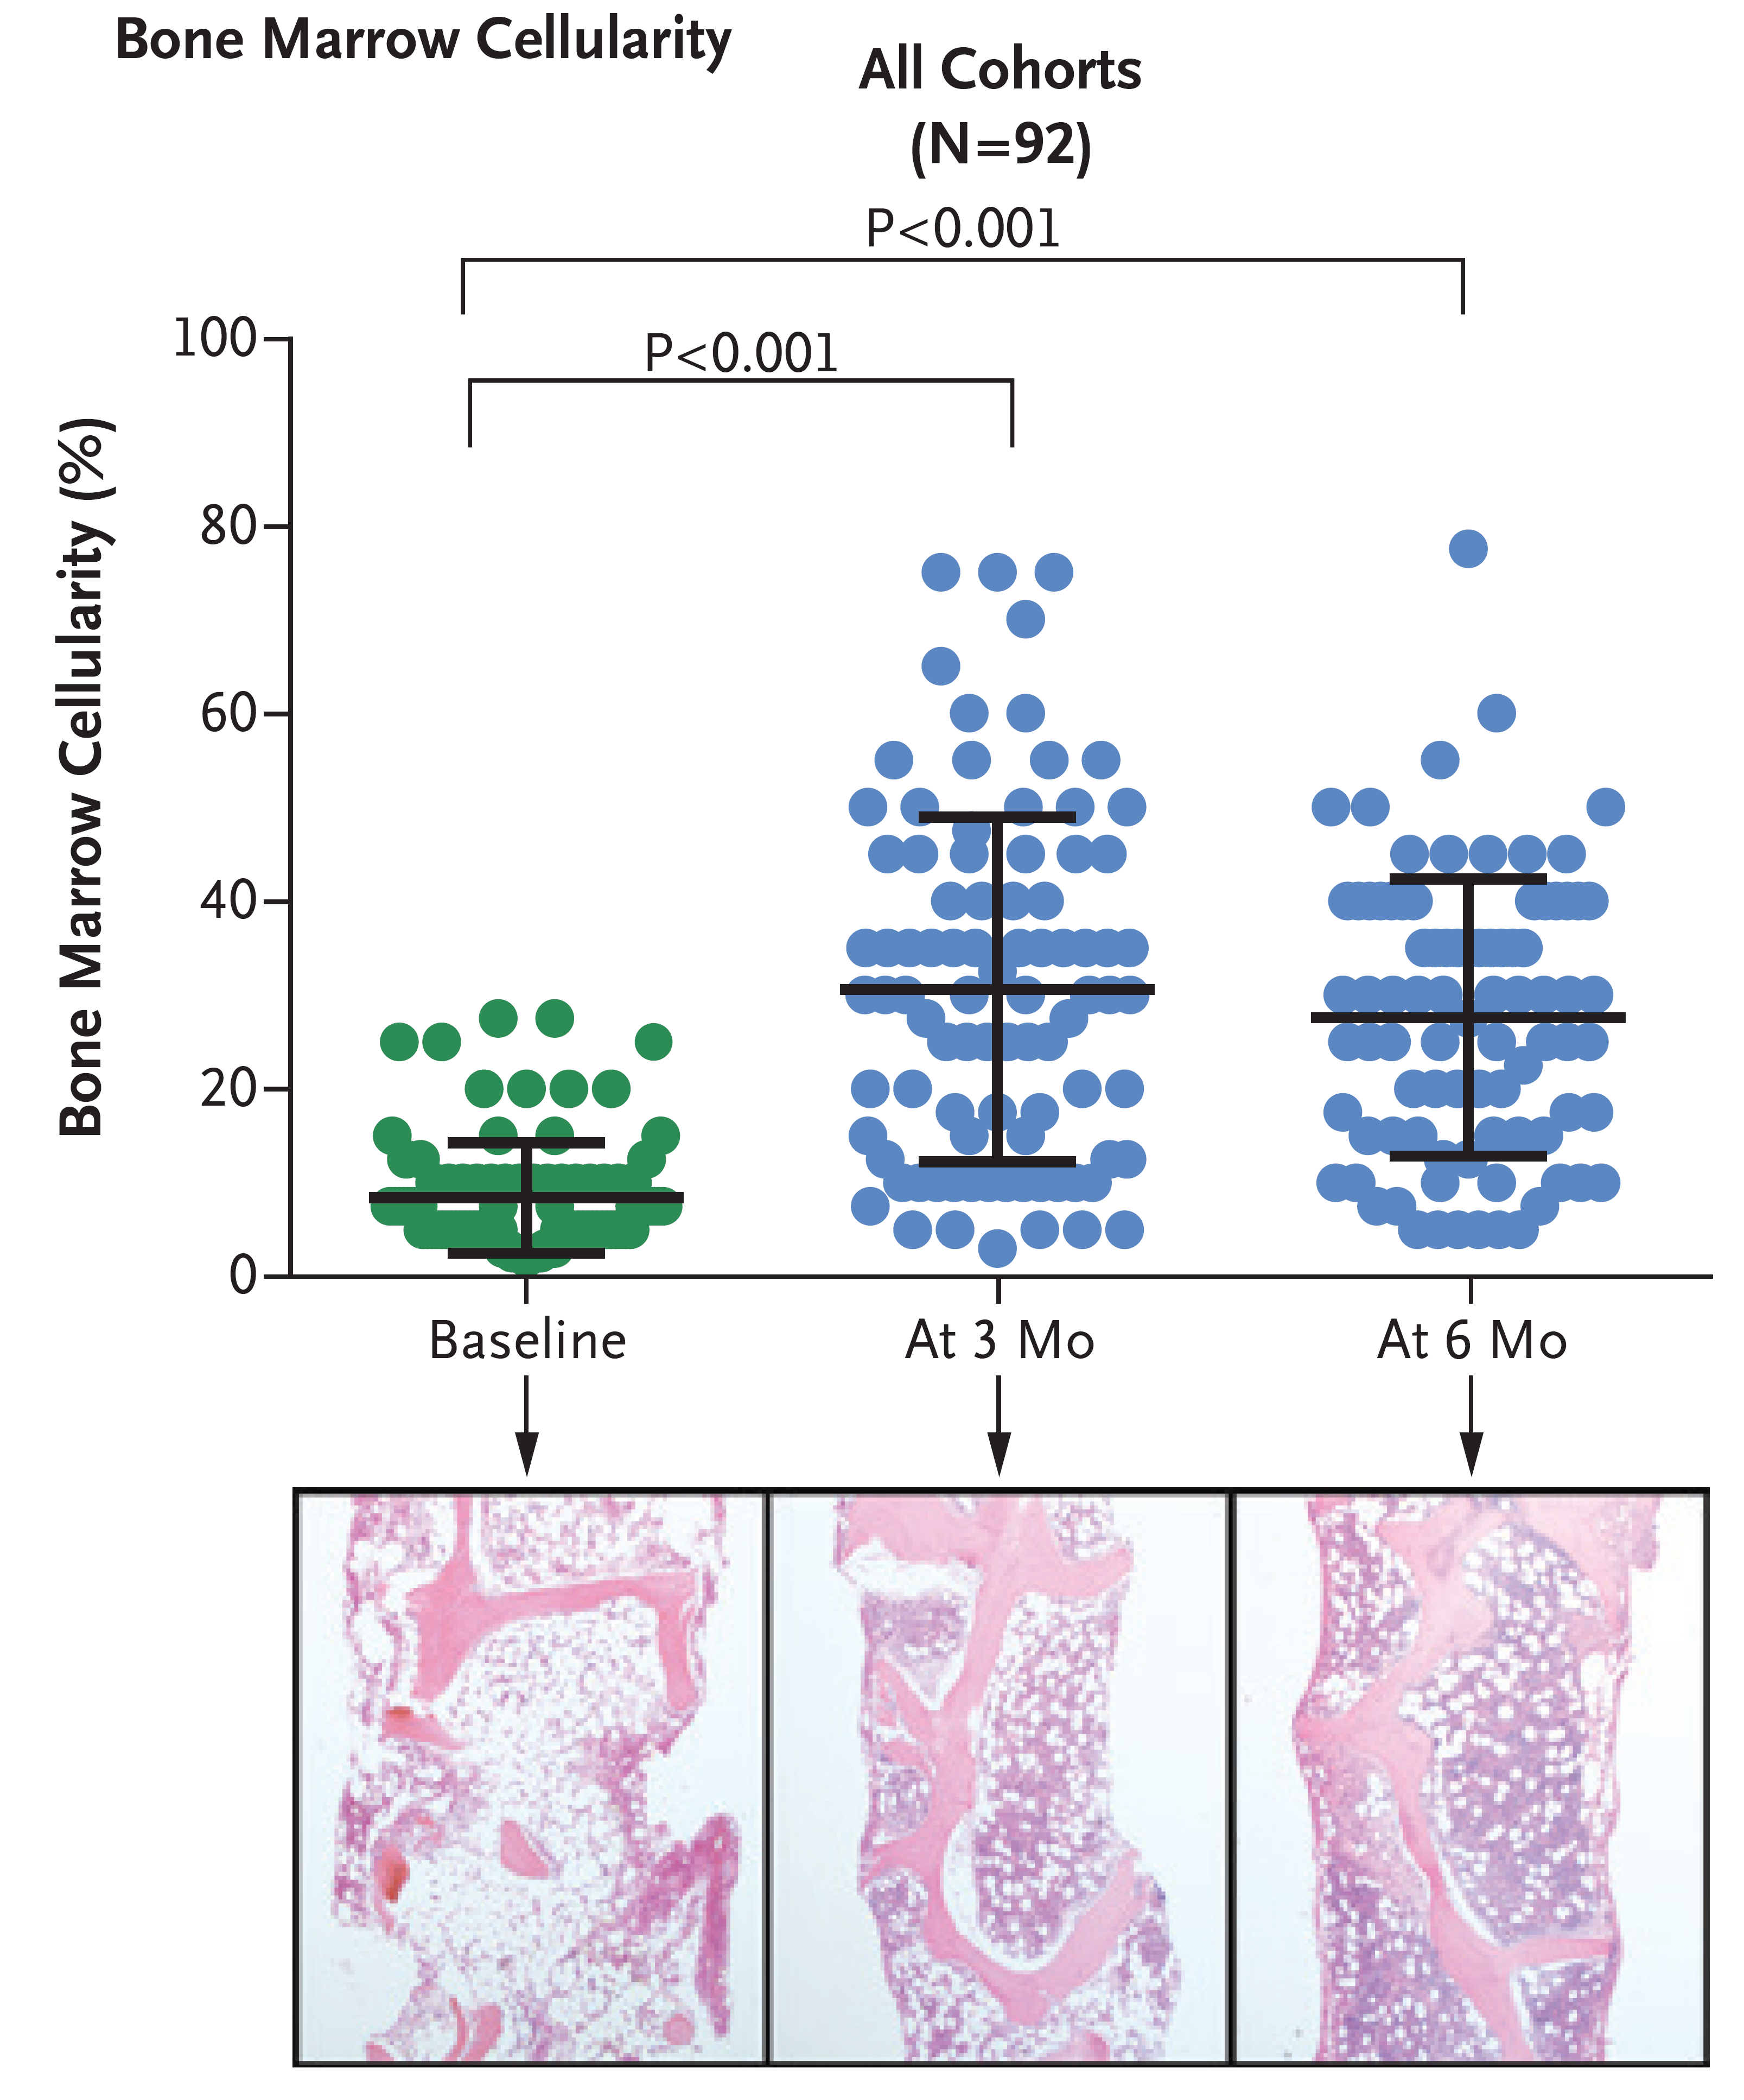
Improved
  Frequency of response (94%)
  Speed of response (1 month)
  robustness of hematologic recovery

Slide 49
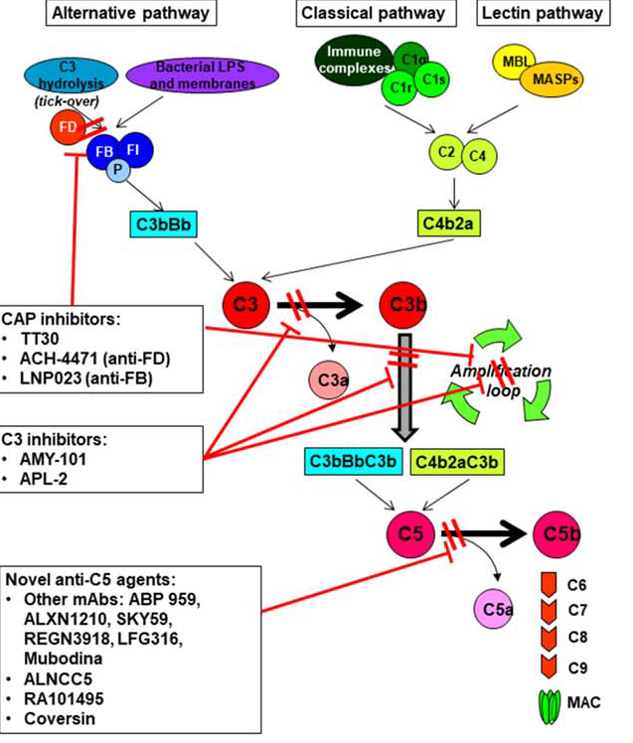
PNH – future trends
>10 novel complement inhibitors under study

Slide 50


Slide 51
Treatment based on classification
Subclinical PNH
  MDS or AA
  PNH clone <1%
  No specific PNH treatment
  Appear to respond better to immunosuppressive therapy.

Slide 52
Treatment based on classification
PNH in the setting of another BM failure syndrome
  Again no specific PNH therapy
  Treatment directed at underlying marrow failure syndrome (i.e. AA or MDS)
    Allogeneic stem cell transplant
    Immunosuppressive therapy.

Slide 53
Treatment based on classification
Classic PNH
  Large clone (>50%)
    Hemolysis, elevated LD, hemoglobinuria
    Lethargy, malaise
    Treated with eculizumab
    +/- anticoagulation
    Treatment of any other causes for cytopenias (i.e. vitamins, bleeding, infections, other medications…)
    +/- danazol
    +/- steroids
    +/- splenectomy

Slide 55
To do
Understand alemtuzumab study
History of AA treatment
NEJM editorial
Organize

Slide 56
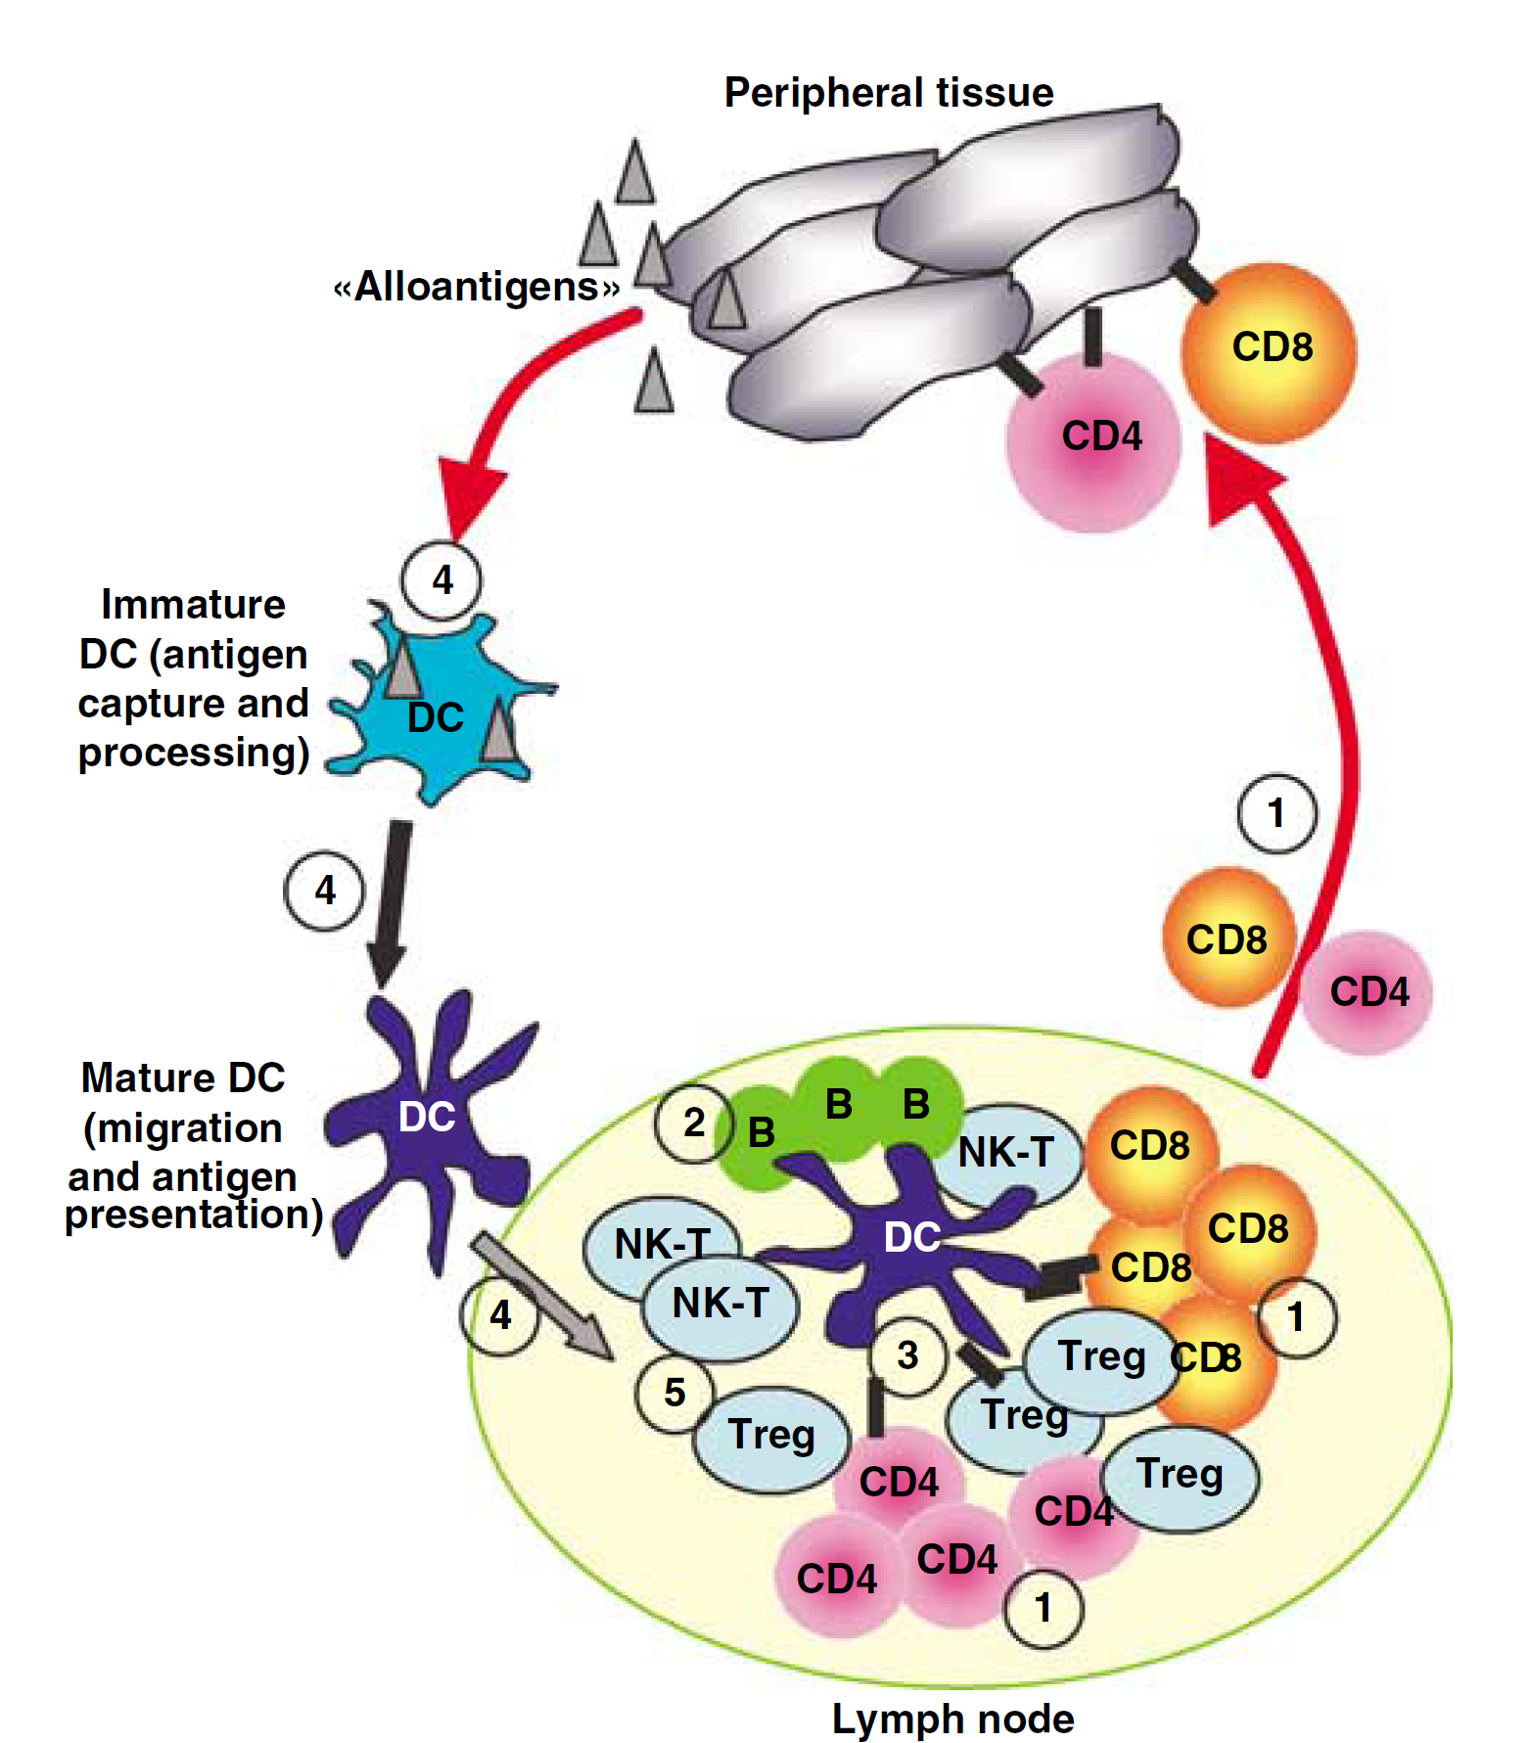
How ATG impairs the immune system
T-cell depletion
B-cell depletion
Interfere with interaction between immune cells
Interfere with function of immune cells
Induction of certain immune cells
Mohty M. Leukemia (2007) 21;1387

